Slide 1

Exam PL-900: Microsoft Power Platform Fundamentals Crash Course
Tim Warner

Slide 2


Tim Warner
Based in Nashville, TN, US
Central time zone
MCT, MVP
Twitter: @TechTrainerTim
Badge: TechTrainerTim.com

Slide 3
Course Materials
timw.info/pl900

Slide 4
Session 1 of 2 Learning Goals
Introduction
Understand the Power Platform
Power Apps
Power Automate

Slide 5
Session 2 of 2 Learning Goals
Power Virtual Agents
Power BI
Lots of PL-900 tips, tricks, and strategies!

Slide 6
A Different Kind of Training
My goals are:
Help you clear your PL-900 exam
Help you get comfortable with the Power Platform
Avoid headaches and confusion I expended for you! ☺
10-minute break at midpoint
I’m here to answer your questions – take advantage of this!
Use the Q&A panel

Slide 7
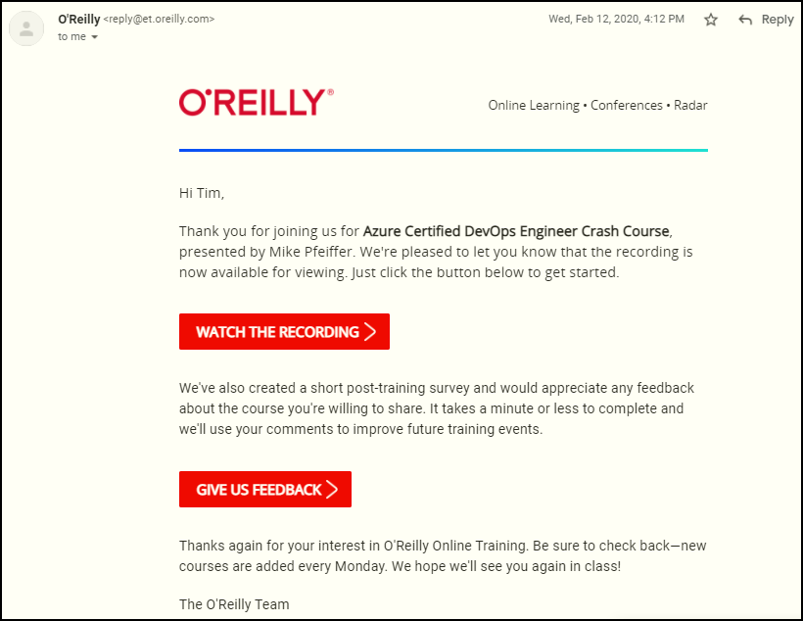
Session Recordings

Slide 8

Session Recordings

Slide 9

Session Recordings

Slide 10

Session Recordings

Slide 11


Mobile Browser: learning.oreilly.com

Slide 12



O'Reilly Mobile App

Slide 13
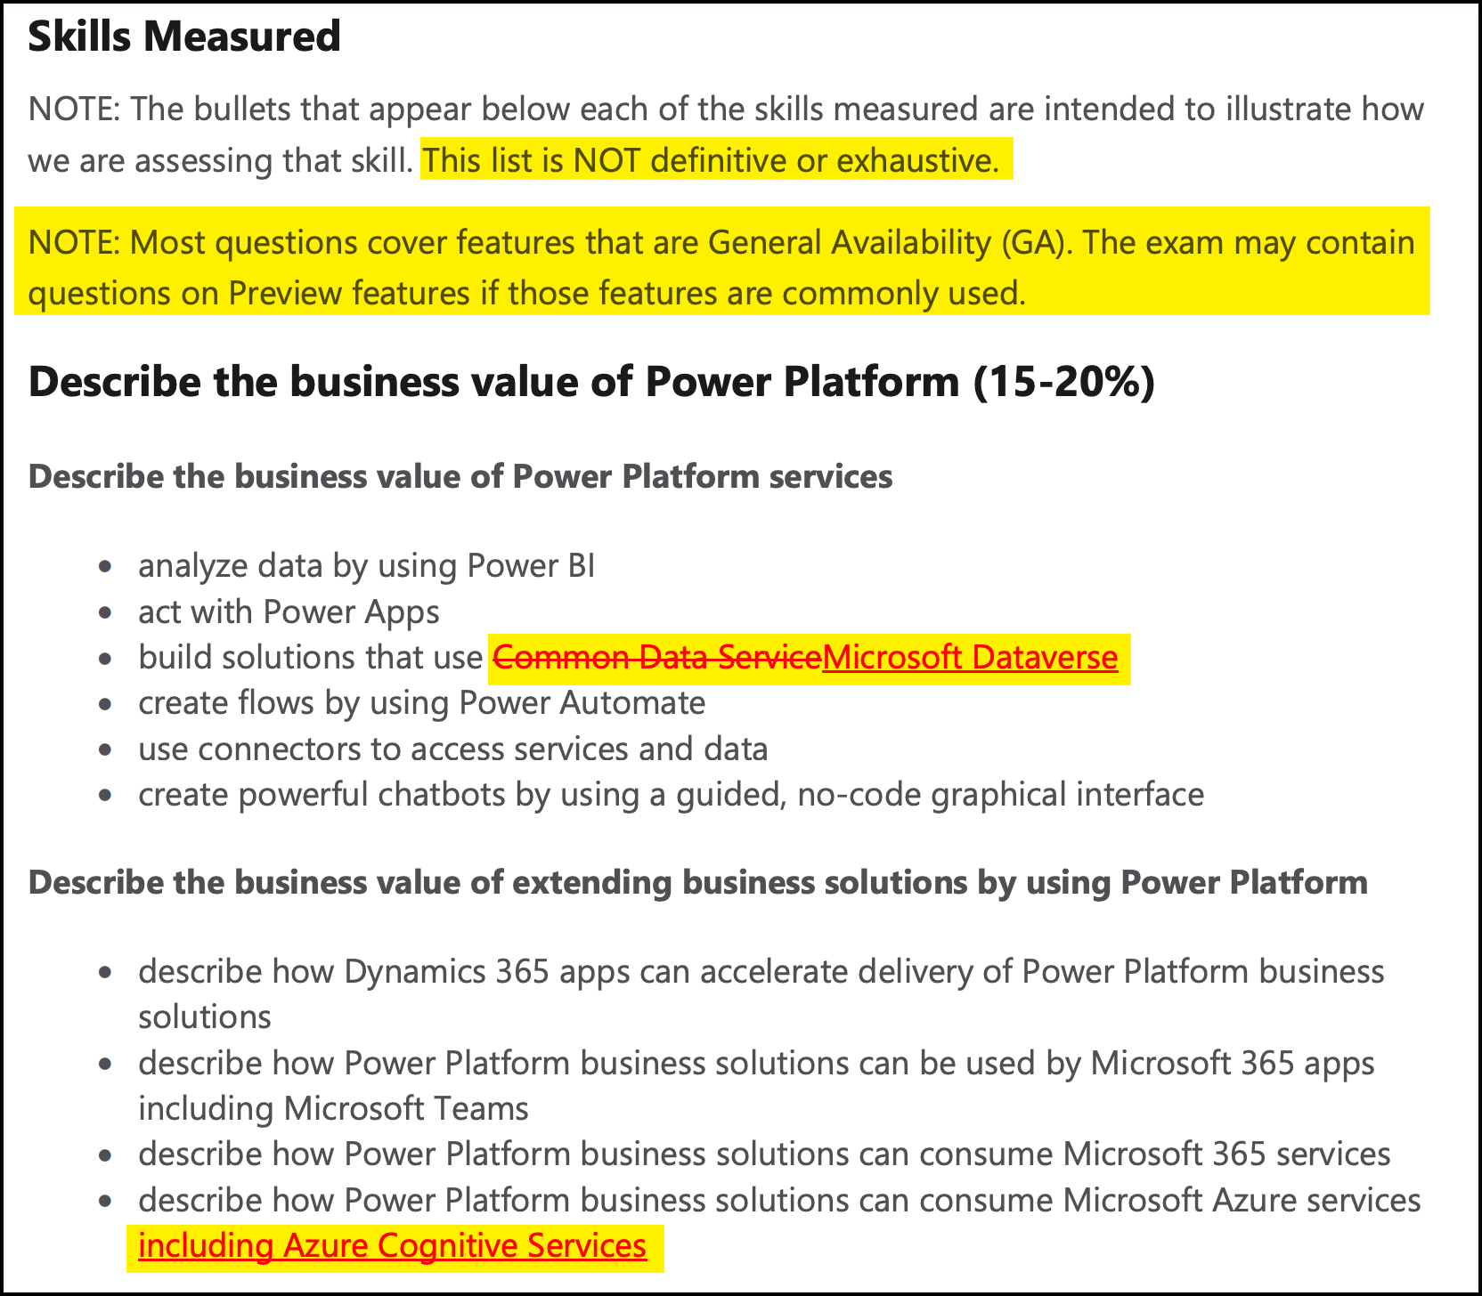
Exam PL-900 Changes: March 10, 2021

Slide 14
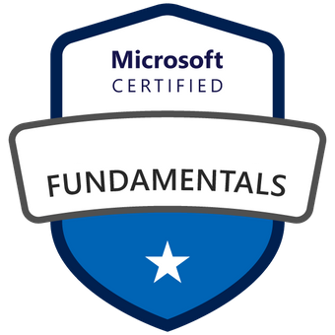



Microsoft Certification Tiers

Slide 15
Who are the *-900 Exams For?
Non-IT people who need conversational familiarity with the subject matter
Cheaper registration
Shorter exam
Lifetime validity
Technical people who will support ”citizen developers”
Non-technical business professionals who need to save money while solving business challenges

Slide 16
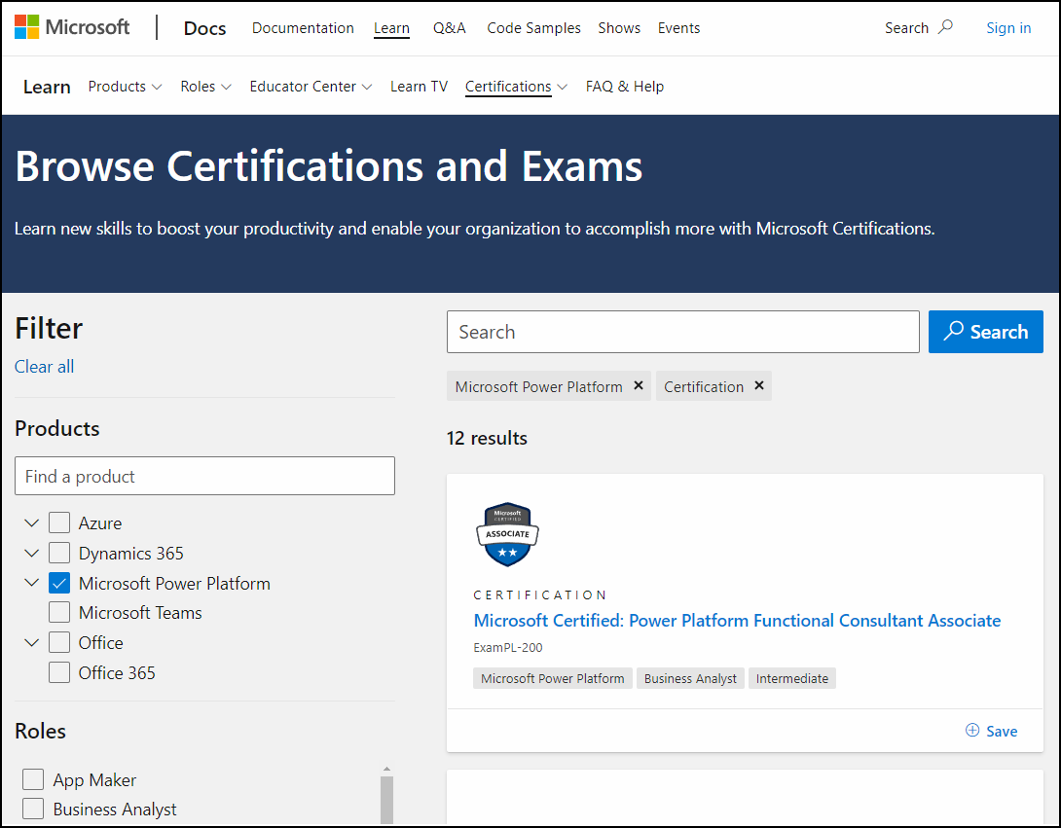
Other Power Platform Certifications
timw.info/ppc

Slide 17

Tim's "Tower Bridge" Certification Study Model

Slide 18
Thank you!
Course materials: timw.info/pl900
Twitter: @TechTrainerTim
Work: timw.info/ps
Web: TechTrainerTim.com

Slide 19
Power Platform Overview

Slide 20


Microsoft Power Platform
The low-code platform that spans Office 365, Azure, Dynamics 365, and standalone applications
Power BI
Business analytics
Power Apps
Application development
Power Automate
Process automation
Power Virtual Agents
Intelligent virtual agents
Data connectors
AI Builder
Dataverse
Notes:
Power Platform is comprised of four key products: Power Apps, Power Automate, and Power BI and Power Virtual Agents.
Power Apps provides a rapid low code development environment for building custom apps for business needs. It has services, connectors, and a scalable data service and app platform (Dataverse) to allow simple integration and interaction with existing data. Power Apps enables the creation of web and mobile applications that run on all devices. People use apps for every area of their lives, and business should be no exception. Most out of the box solutions do not meet exact business needs or integrate well with other business programs. Power Apps eases users into app development with a simple interface so that every business user or pro developer can build custom apps.
Power Automate lets users create automated workflows between applications and services. It helps automate repetitive business processes such as communication, data collections, and decision approvals. If you have ever been performing a repetitive task for work and think, “This is so easy a monkey could do it,” Power Automate is your new best friend. Don't waste important productive hours on drafting the same email for a weekly update or walking approvals through. Not only for the individual user, Power Automate allows for the creation of enterprise-grade process automation. Power Automate's simple interface allows every level of user to automate work tasks from beginners to seasoned developers.
Power BI (Business Intelligence) is a business analytics service that delivers insights for analyzing data. It can share those insights through data visualizations which make up reports and dashboards to enable fast, informed decisions. Power BI scales across an organization, and it has built-in governance and security allowing businesses to focus on using data more than managing it. You can consider Power BI as the analysis and insights leg of the Power Platform. It takes business data and allows you to display it in ways that makes the most sense to users. A Power BI dashboard could potentially replace a standing meeting to report out on company metrics such as sales data, progress against goals, or employee performance.
Power Virtual Agents enables anyone to create powerful chatbots using a guided, no-code graphical interface, without the need for data scientists or developers. Power virtual agents addresses many of the major issues with chatbot building. It eliminates the gap between subject matter experts and the development teams building the chatbots. It removes the complexity of exposing teams to the nuances of conversational AI and the need to write complex code. It minimizes the IT effort required to deploy and maintain a custom conversational solution by empowering subject matter experts to build and maintain their own conversational solutions.

Slide 21
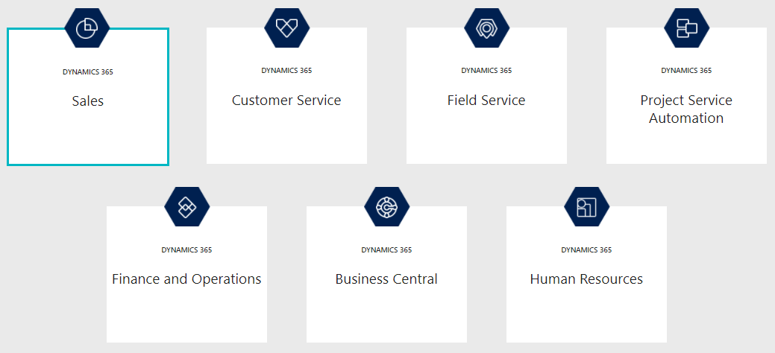
What is Microsoft Dynamics?

Slide 22
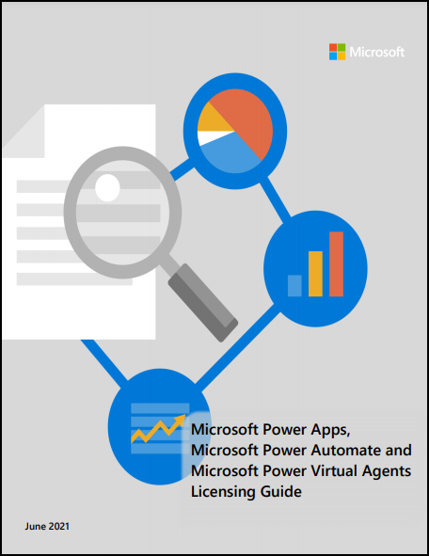
Power Platform Licensing Guide

Slide 23

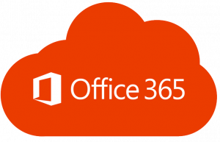


Power Platform Licensing
Entitlements to extend your M365 solutions
Entitlements to extend your M365 solutions
Per user (unlimited apps)
Per app/flow

Slide 24
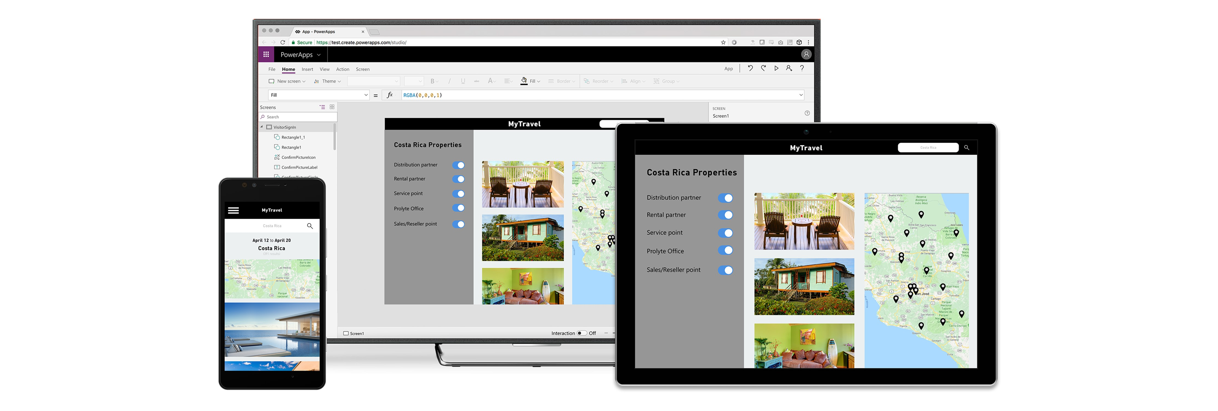
Build and consume solutions for web and mobile with Power Apps
Build highly customized task- and role-based canvas apps with data from one or multiple sources
Generate immersive model-driven apps, starting from your data model and business processes
Consume fully accessible apps across web and mobile, embedded or standalone, on any device
Notes:
Power Apps provides a rapid low code development environment for building custom apps for business needs. It has services, connectors, and a scalable data service and app platform (Dataverse) to allow simple integration and interaction with existing data. Power Apps enables the creation of web and mobile applications that run on all devices.
People use apps for every area of their lives, and business should be no exception. Most out of the box solutions do not meet exact business needs or integrate well with other business programs. Power Apps eases users into app development with a simple interface so that every business user or pro developer can build custom apps.

Slide 25
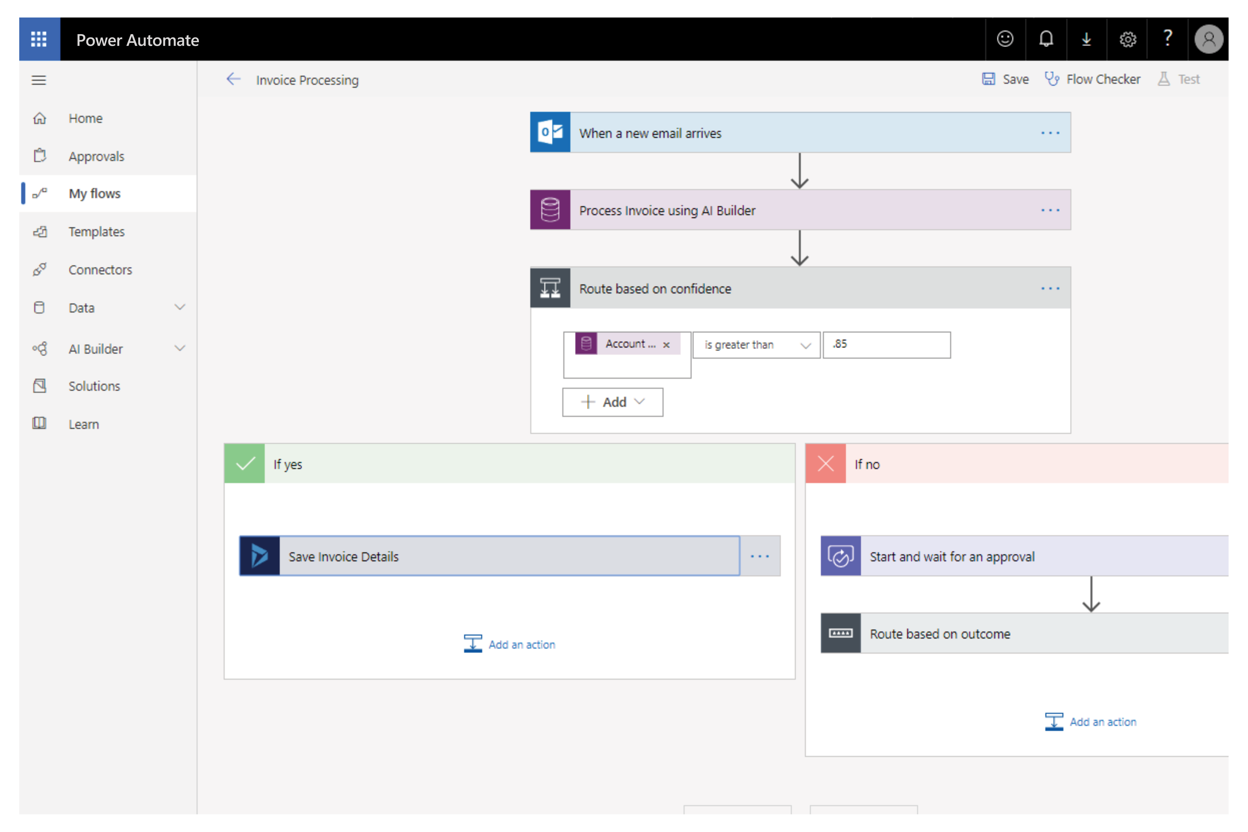
Automate and integrate business processes with Power Automate
Automate and model business processes across your apps and services
From simple automations to advanced scenarios with branches, loops, and more
Trigger actions, grant approvals, and get notifications right where you work
Automate legacy, on-prem and cloud-based applications and services
Notes:
Power Automate lets users create automated workflows between applications and services. It helps automate repetitive business processes such as communication, data collections, and decision approvals.
You can avoid wasiting important productive hours on drafting the same email for a weekly update or walking approvals through. Not only for the individual user, Power Automate allows for the creation of enterprise-grade process automation. Power Automate's simple interface allows every level of user to automate work tasks from beginners to seasoned developers.

Slide 26
Gain insights from your data regardless of where it lives with Power BI
Connect to all your data and get a consolidated view across your business through a single pane of glass
Create ad-hoc analysis, live dashboards and interactive reports that are easy to consume on the web and across mobile devices
Build smart apps by infusing insights from your data and drive action with the power of the Power Platform
Notes:
Power BI (Business Intelligence) is a business analytics service that delivers insights for analyzing data. It can share those insights through data visualizations which make up reports and dashboards to enable fast, informed decisions. Power BI scales across an organization, and it has built-in governance and security allowing businesses to focus on using data more than managing it.
You can consider Power BI as the analysis and insights leg of the Power Platform. It takes business data and allows you to display it in ways that makes the most sense to users. A Power BI dashboard could potentially replace a standing meeting to report out on company metrics such as sales data, progress against goals, or employee performance.

Slide 27

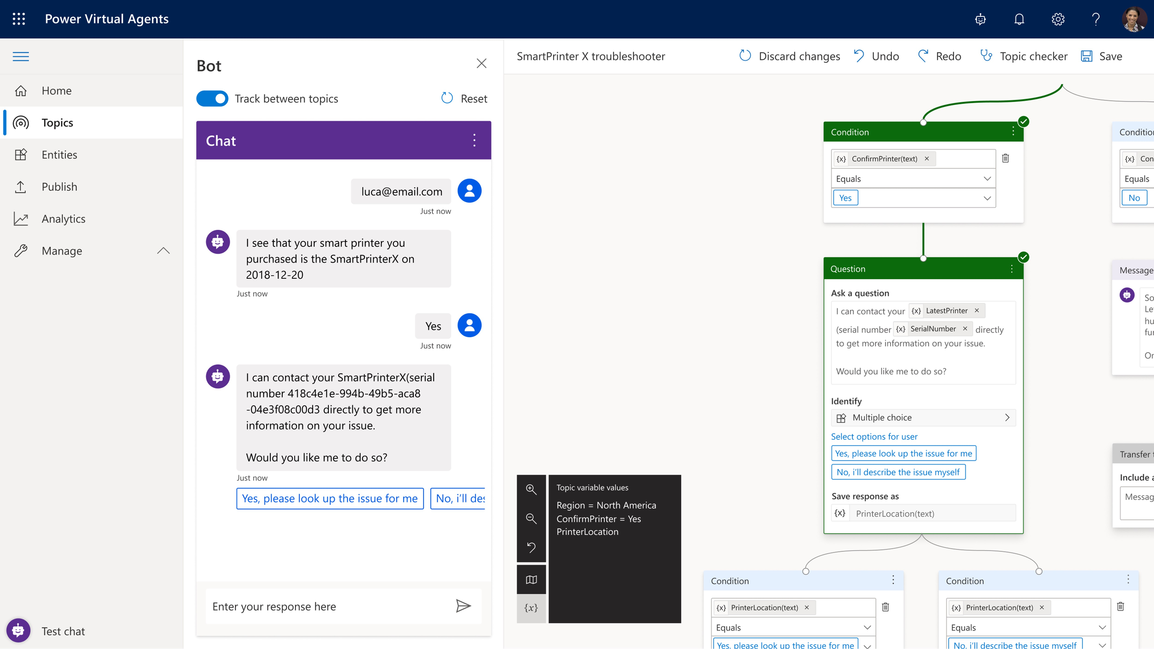
Build powerful chatbots with Power Virtual Agents
Enable subject matter experts to easily create powerful chatbots using a guided, no-code graphical interface—all without the need for data scientists or developers
Enable the virtual agent to act on the customer’s behalf. Easily integrate your virtual agent with hundreds of services and systems out of the box or create custom workflows
Keep an eye on how your virtual agent is performing by using conversational metrics and dashboards. Get in-depth AI-driven insights to improve bot performance
Notes:
Power Virtual Agents enables anyone to create powerful chatbots using a guided, no-code graphical interface, without the need for data scientists or developers.
Power virtual agents addresses many of the major issues with chatbot building. It eliminates the gap between subject matter experts and the development teams building the chatbots. It removes the complexity of exposing teams to the nuances of conversational AI and the need to write complex code. It minimizes the IT effort required to deploy and maintain a custom conversational solution by empowering subject matter experts to build and maintain their own conversational solutions.

Slide 28

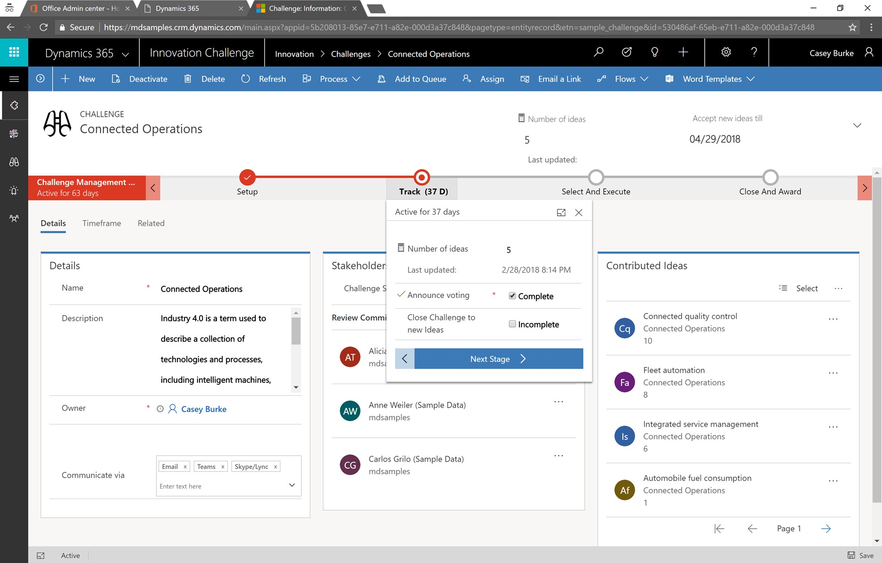
Put all your data to work with Dataverse
Jumpstart apps using a standardized data model with business logic, security and integration built-in
Extend to your own needs and integrate across your apps and services
Seamless Dynamics 365, Office 365, and Azure integration, augmented with data from industry partners
Notes:
Dataverse is a scalable data service and app platform which lets users securely store and manage data from multiple sources and integrate that data in business applications using a common data model to ensure ease and consistency to users. Dataverse is the common currency that enables the components of Power Platform to work together. It’s the foundation that enables the consolidation, display, and manipulation of data.

Slide 29
Data connectors
Connectors are available for use in multiple products:
Power Automate
Power Apps
Logic Apps
Custom connectors:
An advantage of building custom connectors is that they can be used in different platforms, such as PowerApps, Power Automate, and Azure Logic Apps
It allow you to extend your app by calling a publicly available API, or a custom API you're hosting in a cloud provider, such as Azure.
You can create custom connectors using 3 different approaches:
Using a blank custom connector
From an OpenAPI definition
From a Postman collection
Notes:
Power Platform is made powerful by its ability to leverage data across many platforms. To do this, components of the Power Platform use connectors. You can think of connectors as a bridge from your data source to your app or workflow which allows information to be conveyed back and forth. Connectors allow you to extend your business solutions across platforms and add functionality for your users, and Power Platform has more than 275 connectors with the ability to build custom connectors as well.
It is important to note that premium connectors require a paid plan for use. The connector reference in the summary and resources unit lists all connectors and whether they are considered standard or premium. Custom connectors are also considered a premium feature.

Slide 30
Data Loss Prevention, compliance, privacy, and accessibility
Data loss prevention policies:
Data loss prevention (DLP) policies can be scoped at the environment level or tenant level, offering flexibility to craft sensible policies that strike the right balance between protection and productivity.
Compliance and data privacy:
Microsoft is committed to the highest levels of trust, transparency, standards conformance, and regulatory compliance.
Data Protection
Resources to manage GDPR Compliance
Accessibility in the Power Platform:
The Power Platform is accessible and inclusive to all kinds of users all over the world.
An accessible canvas app will allow users with vision, hearing, and other impairments to successfully use the app.
Notes:
Data Protection:
Data as it is in transit between user devices and the Microsoft datacenters are secured. Connections established between customers and Microsoft datacenters are encrypted, and all public endpoints are secured using industry-standard TLS. TLS effectively establishes a security-enhanced browser to server connection to help ensure data confidentiality and integrity between desktops and datacenters. API access from the customer endpoint to the server is also similarly protected. Currently, TLS 1.2 (or higher) is required for accessing the server endpoints.
Resources to manage GDPR Compliance
The European Union General Data Protection Regulation (GDPR) is one of the newest privacy regulations enacted that gives rights to people to manage their personal data. A complete discussion of GDPR is beyond the scope of this content, however the Power Platform does fully support the GDPR. For more GDPR resources and information, visit the Trust Center at https://www.microsoft.com/TrustCenter/Privacy/gdpr/default.aspx .

Slide 31
Microsoft Dataverse

Slide 32
Overview of Microsoft Dataverse
Dataverse: Database storing a set of standard and custom data structures called entities
Entity: Like tables in a relational database
Common Data Model: Set of open-sourced, standardized, extensible data entities and relationships
Part of the Open Data Initiative
Notes:
Dataverse is a cloud-based solution that easily structures a variety of data and business logic to support interconnected applications and processes in a secure and compliant manner. Managed and maintained by Microsoft, Dataverseis available globally but deployed geographically to comply with your potential data residency. It is not designed for stand-alone use on your servers, so you will need an internet connection to access and use it.
Dataverse is designed to be your central data repository for business data, and you might even be using it already. Behind the scenes, it powers many Microsoft Dynamics 365 solutions such as Field Service, Marketing, Customer Service, and Sales. It is also available as part of Power Apps and Power Automate with native connectivity built right in. The AI Builder and Portals features of the Power Platform also utilize Dataverse.
The ease of setting up a Dataverse database and standardized data model under it simplifies your ability to concentrate your efforts on building solutions without worrying about infrastructure, storage, and data integration. With your data stored in Dataverse, there are many different ways to access it. You can work with the data natively with tools such as Power Apps or Power Automate. Or through connectors and APIs you can connect to the Common Data Service from any business solution. With the power of features such as role-based security and business rules you can trust your data is safe no matter how it is accessed.
Microsoft Dataverse defined
A Dataverse database is a single instance of Dataverse which stores data in a set of standard and custom data structures called tables. A table is a logical set of records (rows) that is used to store data. These are like tables in a relational database, but there are subtle differences. Rows (records) within a table contain many columns (fields) to manage individual pieces of information about a single row.

Slide 33
Identify tables and columns in Dataverse
Types of tables:
Standard: Base set of tables, created for every instance of a Dataverse database
Custom: Created for a specific business application
Columns:
Store discrete pieces of information within a record in an entity
Every column has a type, which defines the way you store the data (example: Date columns)
Notes:
Types of tables
Some of the types of tables are:
Standard - The base set of tables that are created for every instance of a Dataverse database. You can add more columns to any entity, but you can only delete columns from a custom entity.
Custom - Custom tables are created for a specific business application. All licensed users of Dataverse can access custom tables if they are assigned proper security permissions to do so.
Complex - Tables that contain complex, server-side business logic, including real-time workflows or plug-ins. Some of the tables that are used in Dynamics 365 applications are complex. Care must be taken if you add server-side logic to ensure that users have the proper license to use the complex entity. Additional information about complex tables can be accessed by following the link within the summary unit of this module.
Always use standard tables and columns when possible. You can rename a table if that makes the table more understandable in the context of your solution. Always review the list of standard tables and make sure a standard table will not meet your needs before you create a new table.

Slide 34
Understand relationships
Relationships: Represent the way that tables are connected
One-to-many relationships:
Can be “parent-child” relationships
Example: An invoice (parent table) can have many line items (child rows)
Many-to-many relationships:
Example: A Contact can attend multiple Events, and an Event can have many Contacts attend
Notes:
Tables that relate to one another have a relational connection. Relationships between tables exist in many forms, but the two most common are one-to-many and many-to-many, both of which are supported by Dataverse.
One-to-many relationships are also known as parent-child relationships. In the previous invoice example, the invoice table would be the parent and the line items would be part of the child table. An invoice can have zero, one, or many line items (child rows), but the line item will always be related to just one invoice (parent record). Typically, the child records will not exist without a parent record.
A column that only allows unique values, such as invoice number, is used to identify the parent record. This unique field is called a key. The same value (the parent key) is stored in the related child rows. This field is called a foreign key when the child record is used to store the parent key value. Ingeniously, filtering is used to display child records with a value in the foreign key that matches the key value in the parent record. This allows applications to display the child records (line items in the previous example) that belong to a particular parent record (invoice in the previous example). This concept underlies many business software applications.

Slide 35

Environments in Microsoft Dataverse
Environments are used to store, manage, and share your organization’s business data, apps, and flows in the Power Platform
Each environment allows you to provision one Dataverse database for use within that environment. Dataverse environments allow you to manage user access, security settings, and the storage that is associated with that database
Each environment is created under a Microsoft Azure Active Directory (Azure AD) tenant, and its resources can only be accessed by users within that tenant
An environment is also bound to a geographic location, like the United States. When you create a Dataverse database in an environment, that database is created within datacenters in that geographic location
Seahorse International (Tenant)
Dev Environment
Dev Environment
Dev Environment
Test Environment
Test Environment
Test Environment
Prod Environment
Prod Environment
Prod Environment
Notes:
You can create more than one environment to manage solution development and data storage by setting up one environment for development, another for testing, and another for production use. Also, you can set up an environment based on a geographical location. For example, you might set up an environment for Europe and another for Asia. Each of these environments will have zero or only one instance of Dataverse.

Slide 36
Power Apps

Slide 37
Power Apps and what it can do for you
Low/no-code platform for building apps
Work with data where it lives
Types of Power Apps:
Canvas apps: Build an app from a blank canvas
Model-driven apps: Build from data in Microsoft Dataverse
Portals: Externally-facing websites
Add artificial intelligence to your app with no code
The prediction model: Create a model with AI Builder that can predict a yes or no answer based on historical data
Notes:
Do you have inefficient or legacy business processes that you would like to modernize? Are you still moving information around using paper or even a shared Excel workbook? Do you want to be able to perform these business processes from different devices like PCs or mobile phones? Then you need Power Apps.
Power Apps is a no-code/low-code platform for building apps that builds off of concepts similar to formulas in an excel workbook such as SUM and TEXT. You can use Power Apps to build simple solutions like vehicle inspection forms and status reports or complex business solutions for purchasing processes and inventory management. If you can envision an app to solve a business problem, then you can use your existing skills to build it. Although this module is geared towards business users with little background in computer science and coding, Power Apps offers advanced functionality and the ability for seasoned developers to design complex applications with ease.

Slide 38

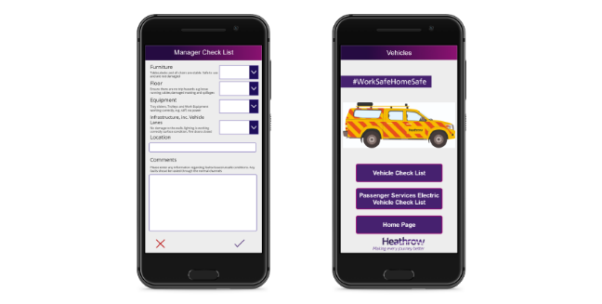
Canvas apps
Canvas apps are a great option when you want to build an app from a blank canvas. You start by choosing the screen size: tablet or mobile, then you have a blank screen from which to build
You can interact with data in your app by adding data sources. Drag and drop various controls and add the desired functionality by writing Excel style formulas. Canvas apps provide you complete flexibility when building your apps

Slide 39
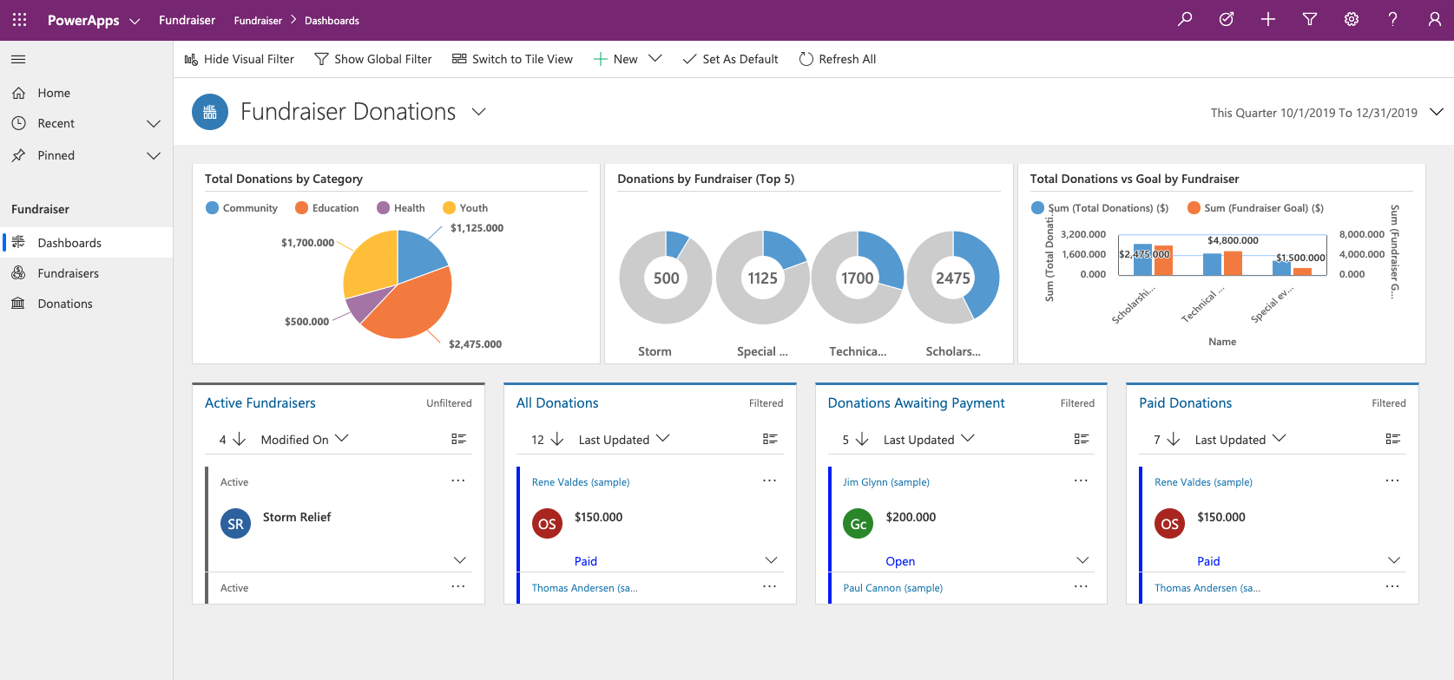
Model-driven apps
Model-driven apps build from data in Microsoft Dataverse. Power Apps will build you a great looking, fully functional app to act upon and interact with this data. With model-driven apps, there is no need to worry about choosing the app size; it is responsive, meaning it works on mobile or tablet with no extra work by you
You define the relationships, forms, views, business rules, and more at the data layer, inside of Dataverse, giving you enough control to get your business result without writing all the formulas yourself

Slide 40
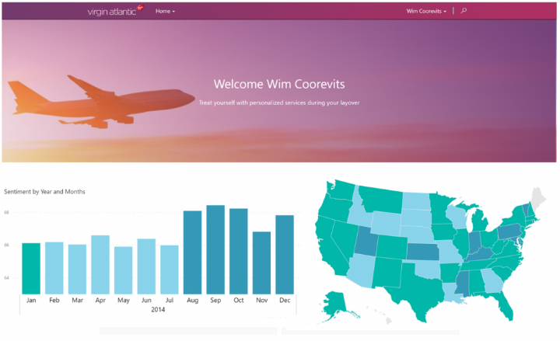
Portals
Portals bring the power of no-code solutions to building externally facing websites. Through the Power Apps interface, you can build an anonymous or authenticated website that allows users to interact with data held in Dataverse.
The same drag and drop experience you enjoy when building apps is available to build these rich, interactive websites.

Slide 41
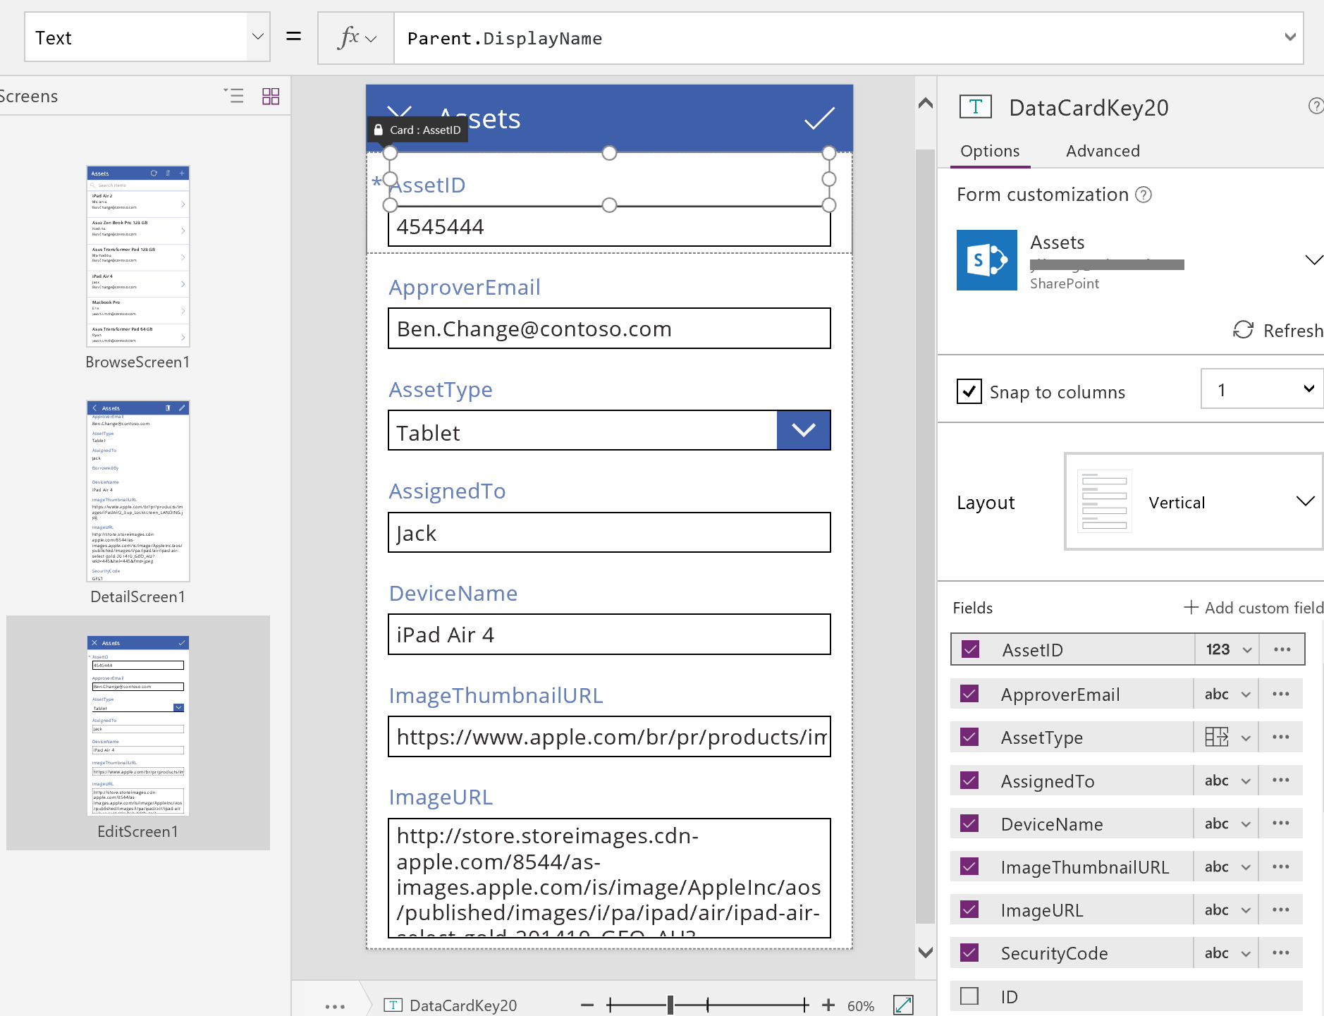
Forms
Notes:
Forms
Forms are focused on working with a specific table row, often based on a selection from a gallery. In this experience, a user browses a gallery to find and select the desired row displaying the details on the form. Forms enable a user to not only view detailed information, but to save new rows and edit existing ones. The various actions performed with forms are controlled by form modes allowing the form to serve many purposes.

Slide 42
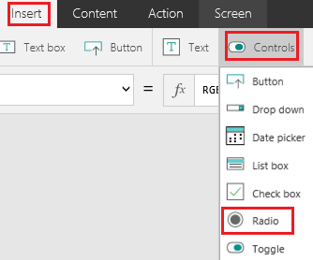
Input Controls
Notes:
Input Controls
To allow you maximum flexibility in customizing your apps, Power Apps has a large selection of Input controls. Text inputs, buttons, dropdowns, toggles, date pickers, and sliders are a few examples. You can add these controls to galleries, forms, and screens to build a functional and aesthetic experience for your app. All inputs have a multitude of settings for default data, formatting, and actions which allow you to build an app that has the right user experience for your business process.

Slide 43
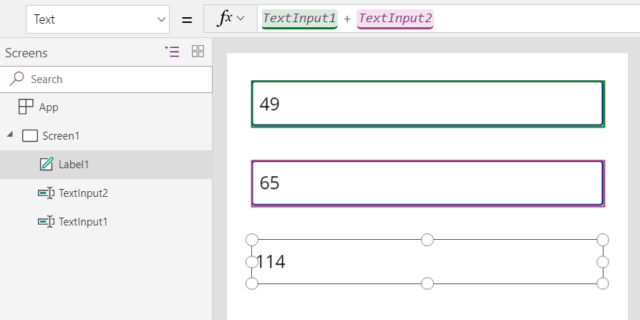
Functions
Formulas combine many elements. Listed below are:
Functions take parameters, perform an operation, and return a value. For example, Sqrt(25) returns 5. Functions are modeled after Microsoft Excel functions. Some functions have side effects, such as SubmitForm, which are appropriate only in a behavior formula such as Button.OnSelect.
Signals return information about the environment. For example, Location returns the device's current GPS coordinates. Signals don't take parameters or have side effects.
Enumerations return a pre-defined constant value. For example, Color is an enumeration that has pre-defined values for Color.Red, Color.Blue, and so forth. Common enumerations are included here; function-specific enumerations are described with the function.
Named operators, such as ThisItem and Parent, provide access to information from within a container.
Notes:
Functions
Functions are the glue that binds all these controls, inputs, and data sources together. You can use one or more functions to create formulas in your apps. These formulas are similar to the language you use in Excel and can be used for actions such as sending data to a data source, formatting information, creating animations, and more. No complicated code is necessary, simply powerful functions with straightforward inputs to enhance your app.
Now that you have an overview of some of the rich functionality you can achieve with Power Apps, the next section will walk you down the path of building your first app in the next Exercise.

Slide 44
Share an app
Prepare to share an app:
Save the app
Click “Share”
Specify users or groups
Consider security groups
Permissions:
Users and contributors need permissions to any data connects and gateways that a shared app uses
Some permissions are implicit; others must be explicitly granted
Notes:
Now that you've created an app, you can share it with specific users, groups, or your whole organization. When you share an app with other people, they can run it in a browser, or in the players for Apple iOS and Google Android.
Even better, you can give someone permission to update the app.

Slide 45
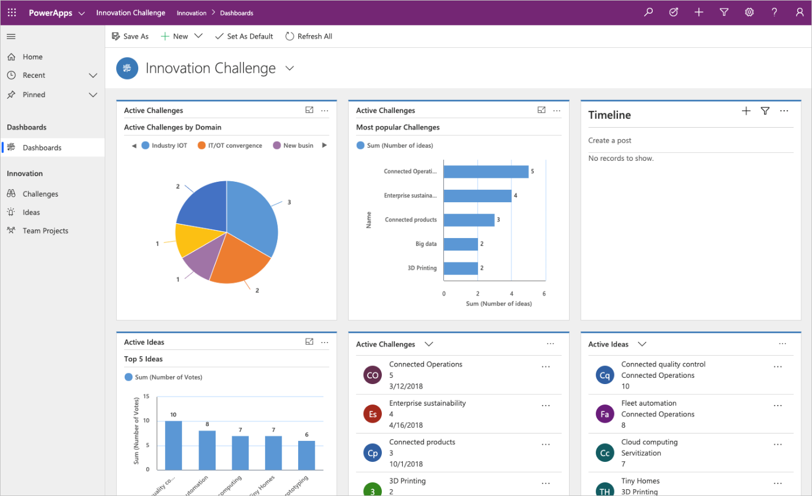
Model-driven apps
Model-driven app design is a component-focused approach to app development, and it does not require code, and the apps you make can be simple or very complex.
The approach to making model-driven apps:
Model your business data
Define your business processes
Build the app
Notes:
Model-driven app design is a component-focused approach to app development. Model-driven app design does not require code, and the apps you make can be simple or very complex. Unlike canvas app development, where the designer has complete control over app layout, much of the layout is determined for you with model-driven apps and largely designated by the components you add to the app.
Model your business data
Model-driven design uses metadata-driven architecture so that designers can customize apps without writing code. To model business data, you determine what data the app will need and how that data will relate to other data. Metadata means data about data and defines the structure of the data stored in Dataverse.
Define your business processes
Defining and enforcing consistent business processes is a key aspect of model-driven app design. Consistent processes help ensure that your app users can focus on their work and not worry about having to remember to perform a set of manual steps. Processes can be simple or complex, and they often change over time.
Build the app
After modeling data and defining processes, you build your app by selecting and setting up the components you need in the App Designer.

Slide 46




Building blocks of model-driven apps
Data
Tables
Columns
Relationships
User interface
App
Site map
Forms
Views
Logic
Business
process flows
Workflows
Actions
Business rules
Flows
Visualization
Charts
Dashboards
Embedded Power BI
Notes:
A model-driven app consists of several components that you select by using the App Designer. The components and component properties become the metadata. These components includes:
Data
Different data components that can make up a model-driven app which can determine what data the app:
Tables
Columns
Relationships
User interface
The user interface components which determine how users will interact with the app and what designer is used to create or edit the component.
App
Site map
Forms
Views
Logic
The logic components determine what business processes, rules, and automation the app will have. Logic types:
Business process flows
Workflows
Actions
Business rules
Flows
Visualization
The visualization components determine what type of data and reporting the app will show and have available and which designer is used to create or edit that component.
Charts
Dashboards
Embedded Power BI

Slide 47
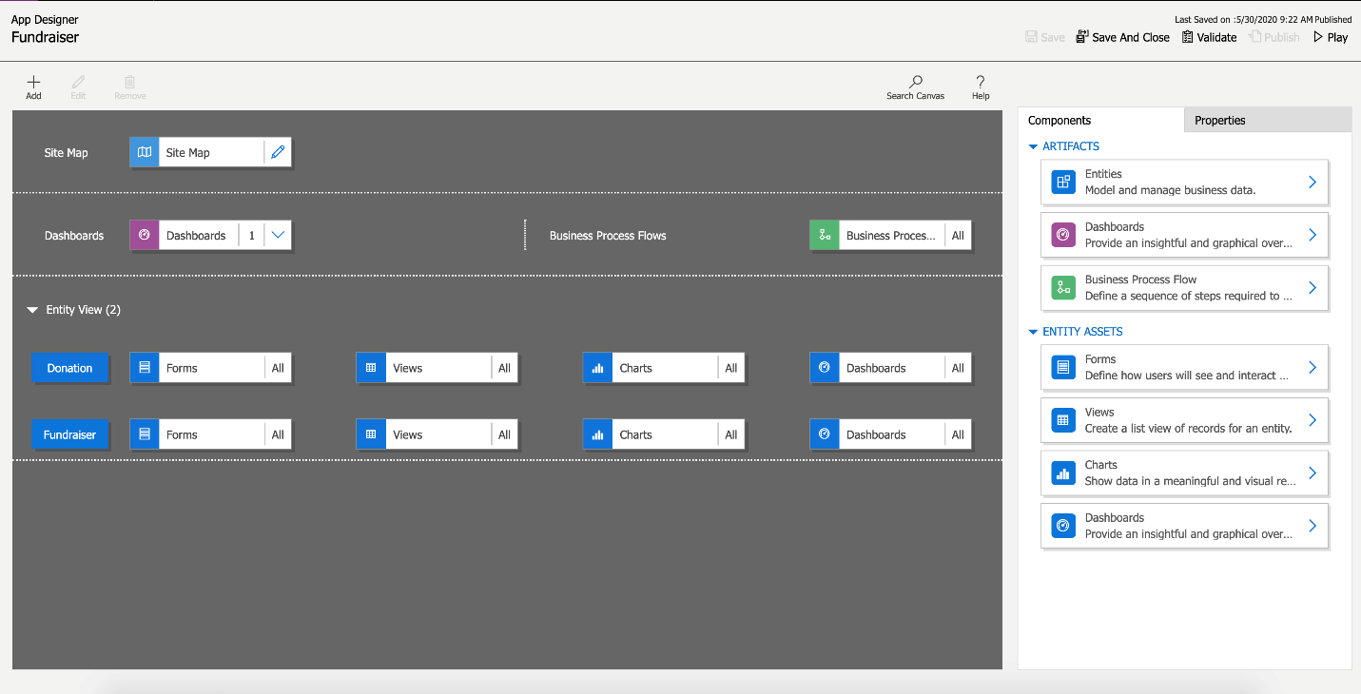
Design of model-driven apps
Forms
Defining how users will see and interact with the data
Views
A list view of the rows for each table
Charts
Showing the data in a meaningful, visual representation
Dashboards
Providing an insightful, graphical overview of the data
Notes:
By selecting the Play button in the top right, the app is put into Play mode. You can see it then looks completely different and shows the data based on the choices made in the design process.

Slide 48
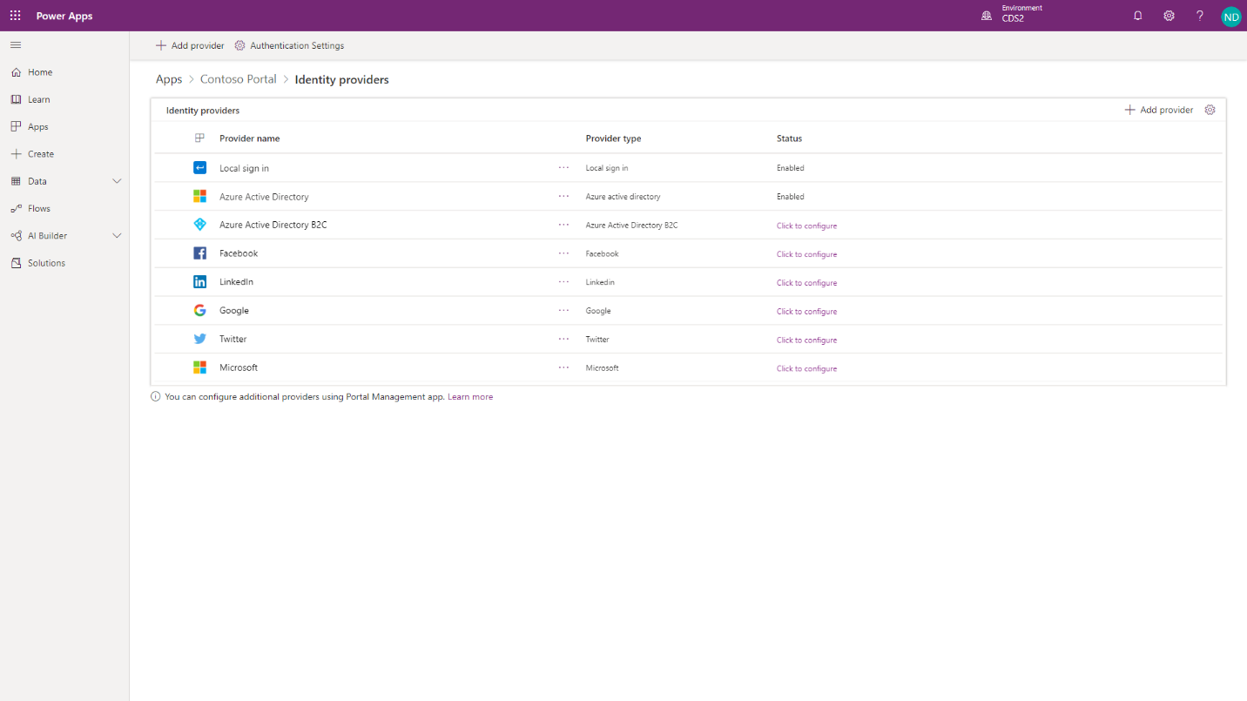
Authentication
Notes:
Portal users can authenticate by using the following methods:
Local authentication - Basic authentication with usernames and passwords are stored in the Common Data Service contact record internally.
External authentication - Credentials and password management are handled by other identity providers. Supported authentication providers include:
OAuth2 (Microsoft, Twitter, Facebook, Google, LinkedIn, Yahoo)
Open ID (Azure Active Directory, Azure Active Directory B2C)
WS-Federation and SAML 2.0 (used for integration with on-premises Active Directory and other identity services)
Portal administrators can choose to enable or disable any combination of authentication options through portal Authentication Settings.
IMPORTANT: AZURE Active Directory B2C is the recommended identity provider for authentication. If another provider support is required, then it can be configured in Azure Active Directory B2C.

Slide 49
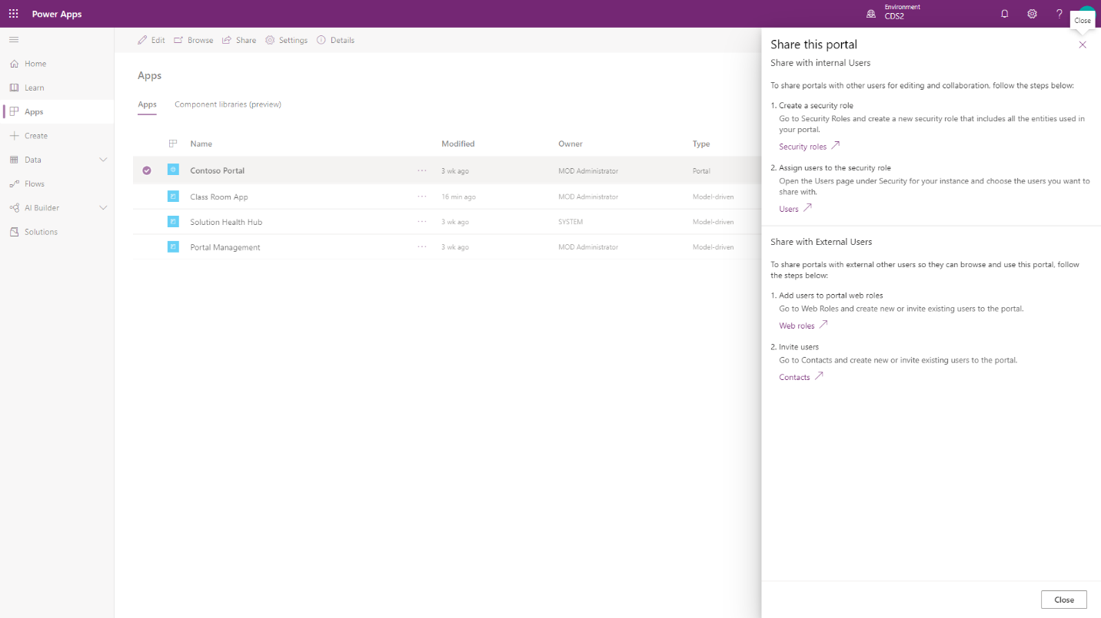
Authorization
Notes:
After the user is authenticated and associated with a contact, Power Apps portals use numerous entities to define authorization, that is, what a user is allowed to do. Selecting Share from the portal app options will provide information on how to share the portal app with internal and external users.

Slide 50
Power Automate

Slide 51
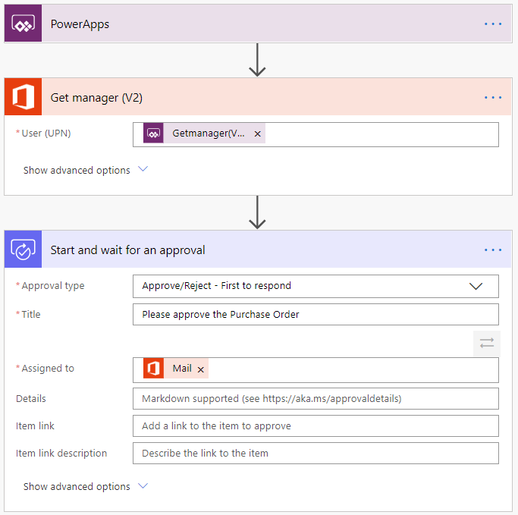
The value Power Automate brings
Common scenarios and capabilities:
Automating repetitive tasks
Guiding a user through a process
Connecting to external data sources
Automating desktop-based processes
Notes:
Do you find yourself downloading email attachments and then uploading the file to the database? Power Automate can help. Does the process of getting a new purchase order approved involve you taking a form from desk to desk to get sign off? Power Automate can help. Do you have to log into a website every morning, find the daily numbers, and then save those into another system? Power Automate can help.
Power Automate is all about having computers manage repetitive tasks. Power Automate allows anyone with knowledge of the business process to create a repeatable flow that when triggered, leaps into action and performs the process.
Common scenarios and capabilities of Power Automate:
Automating of repetitive tasks like moving data from one system to another
Guiding a user through a process so they can complete the different stages
Connecting to external data sources via one of the hundreds of connectors or directly via an API
Automating desktop based processes with robotic process automation (RPA) capabilities
Will dive into the example flow in next slides

Slide 52
Example: A purchase order approval
Approvals are a great process to build in Power Automate. They are often – defined yet manual. Check out the following scenario for an example:
A user starts the process by going into a Power Apps app and creating a purchase order request. Once they submit the request the information is sent to a Power Automate flow
The flow can be built to evaluate the request and then route the request based on criteria such as submitting user and request amount. The first action could be to send the request to the user’s manager. The manager could be automatically retrieved from Azure AD avoiding prompting for duplicate information

Slide 53
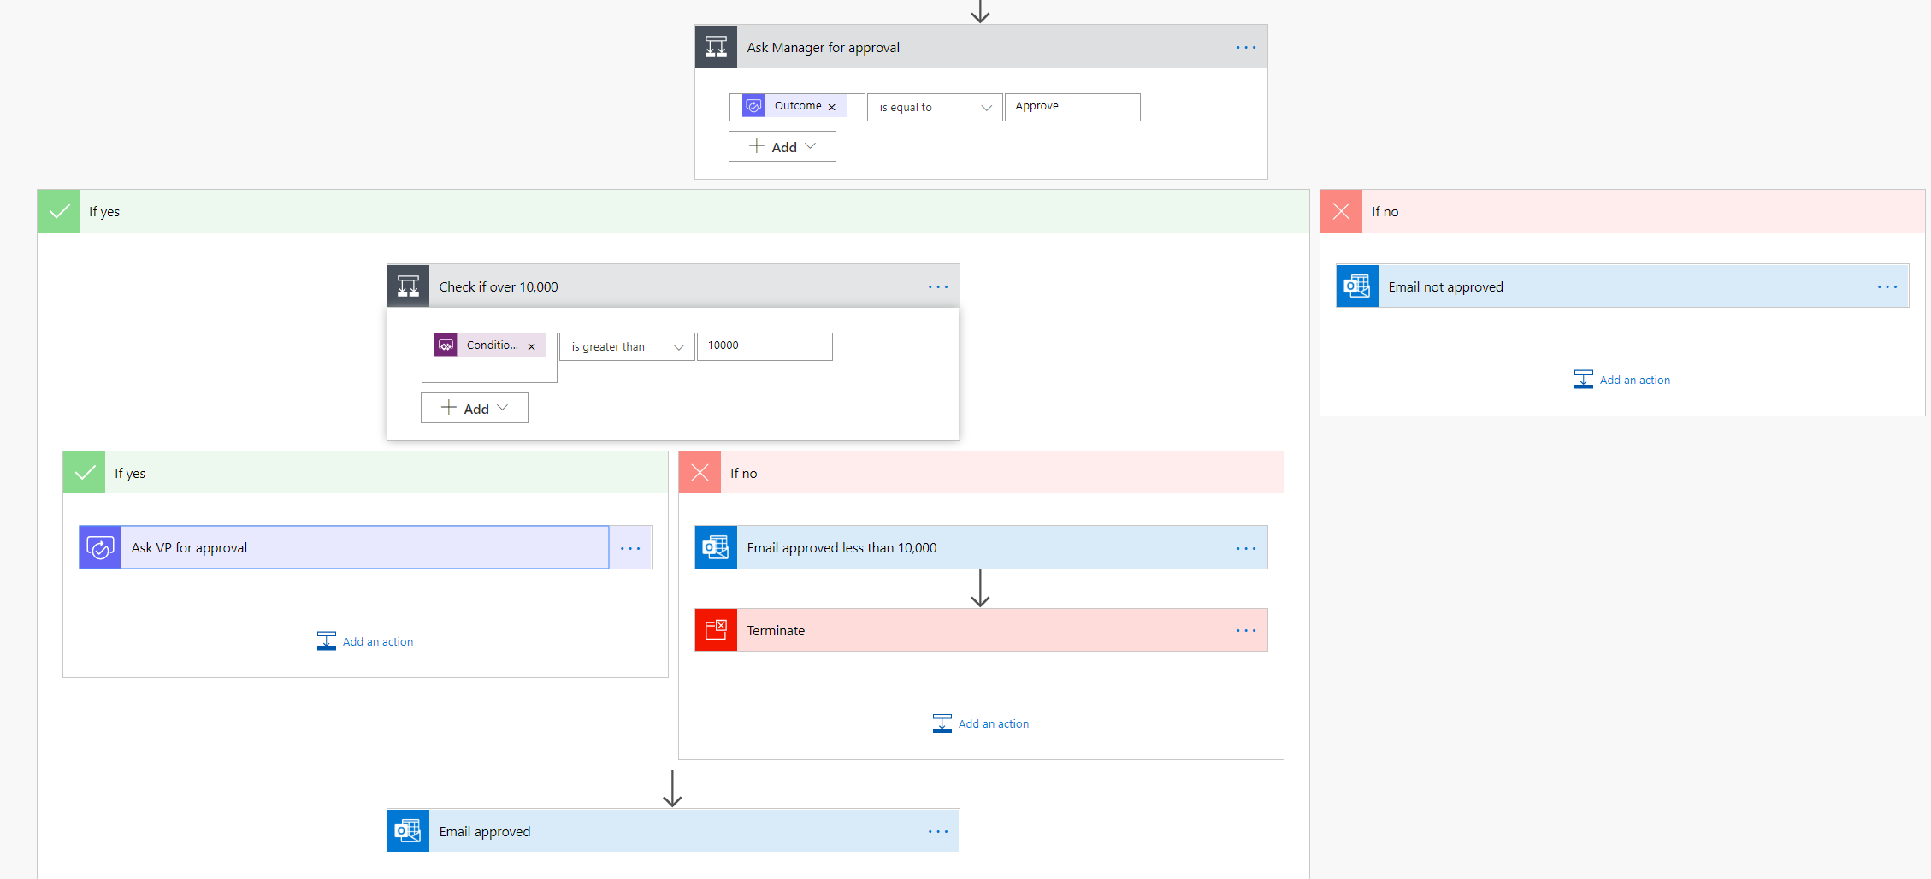
Example: A purchase order approval – continued
After the manager receives the approval and approves, the flow can then provide conditional logic. Typically this might be something like if the purchase order request is greater than $10,000 send it to VP if not then automatically approve the purchase order
Here is an example of what this flow may look like
Notes:
As you can see even the business process has many decision points. Your flow easily handles the decisions without you writing any code.

Slide 54
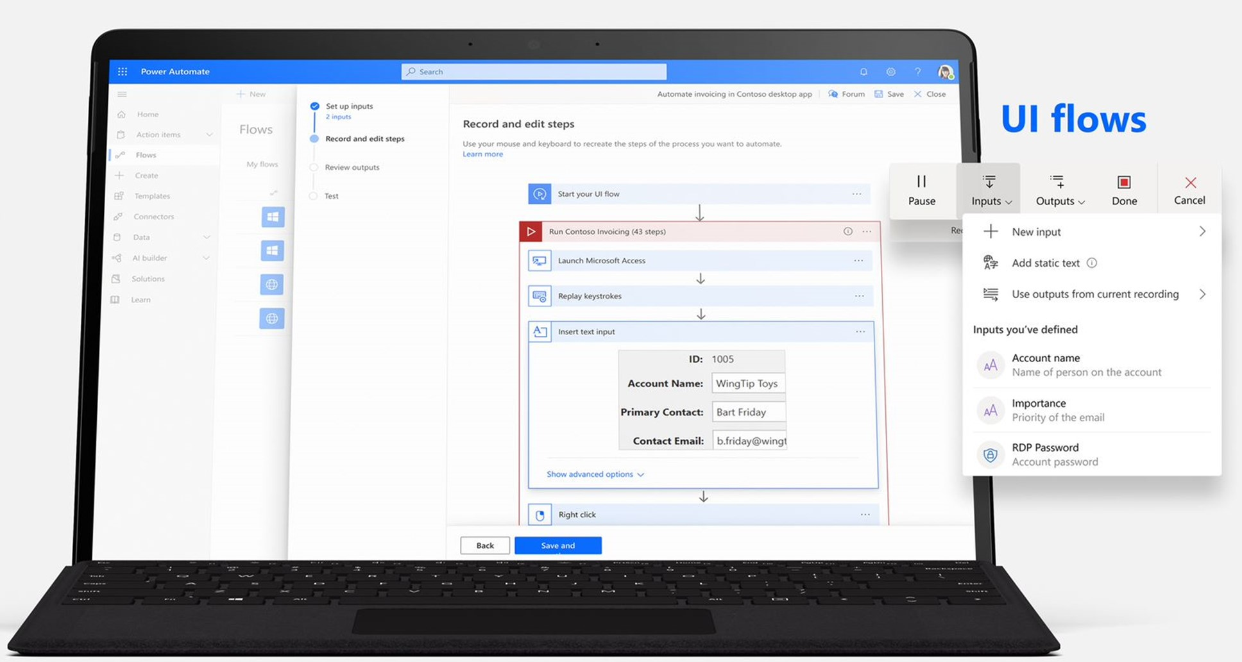
The three types of flows you can create with Power Automate
Power Automate works by creating flows, of which there are three types:
Event driven flows
Business process flows
Desktop flows
Notes:
Power Automate works by creating flows, of which there are three types:
Event driven flows - These are flows that you build with a trigger and then one or more actions. There are a multitude of triggers and actions available, thanks to the existing connectors. You will see these as My flows and Team flows in Power Automate. The only difference between a My flow and a Team flow is ownership. With a My flow you are the sole owner, while a Team flow has more than one owner.
Business process flows - These flows are built to augment the experience when using Model-driven apps and Dataverse. Use these to create a guided experience in your Model-driven apps.
Desktop flows – Formerly known as UI flows. These robotic process automation (RPA) flows allow you to record yourself performing actions on your desktop or within a web browser. You can then trigger a flow to perform that process for you. You can also pass data in or get data out of the process, letting you automate even "manual" business processes.

Slide 55
Add artificial intelligence to your flow without writing code
To take advantage of these AI capabilities you must first build a model. From make.PowerApps.com a wizard guides you through building and training the model. Currently, there are four available AI models available to build:
Form processor:
This model extracts text from an uploaded image or taken photo
Object detector:
This model identifies objects from an uploaded image or taken photo and then provides a count of the number objects present
Prediction:
This model predicts whether something will happen or not based on previous data history. More details in the following section
Text classification:
This model categorizes text by its meaning, making it is easier to analyze

Slide 56
Important concepts in Microsoft Power Automate
Keep these concepts in mind when building flows:
Every flow has two main parts:
a trigger
one or more actions
Think of the trigger as the starting action for the flow
Actions are what you want to happen when a trigger is invoked.
Some examples of types of actions you can have in a flow include:
Loops
Switch
Do Until
Apply to each
Expressions
Notes:
Keep these concepts in mind when building flows:
Every flow has two main parts: a trigger, and one or more actions.
You can think of the trigger as the starting action for the flow. The trigger can be something like a new email arriving in your inbox or a new item being added to a SharePoint list.
Actions are what you want to happen when a trigger is invoked. For example, the new email trigger will start the action of creating a new file on OneDrive for Business. Other examples of actions include sending an email, posting a tweet, and starting an approval.
Some examples of types of actions you can have in a flow include:
Loops – Runs an action until conditions are met to move to the next step of the flow
Switch – Identifies a single case to execute based on the evaluation of input
Do Until – Executes a block of actions until a specified condition evaluates to true
Apply to each – Executes a block of actions for each item in the input array
Expressions – underlying definition that describes the actual logic that runs in your flow that can be manually written
You can also perform data operations in your flow, such as Compose, Create CSV table, Join, or Select. These concepts will come into play later when you build your own flows from scratch.

Slide 57
Trigger or run the flow
With Power Automate, you don’t think of running a flow the same way as you do with Power Apps. Instead, you perform the activity that triggers the flow to run.
When defining triggers, there are a few different types:
When something changes:
These are triggers that run when data is changed. It could be a new item created in SharePoint, a lead is updated in Dynamics, or when an event has been deleted from Outlook for example
On a schedule:
You can set up a flow to be triggered at a certain time of a day and with a recurrence. This allows for workflows such as checking every day at 8 AM if there are account renewals pending and if so, sending an email to the necessary people
On a button press:
This trigger takes shape in many different ways. This can be when a flow virtual button is run through the mobile app, or a physical button is clicked with 3rd party options, or even when a button is pressed inside of Power Apps. This gives you that control to “run” a flow on-demand
Notes:
With Power Automate, you do not think of running a flow the same way as you do with running a Power Apps app. Instead, you perform the activity that triggers the flow to run. In the case of the previous flow, instead of periodically running the flow manually, it would automatically run every time a new email is received with an attachment. This is because the flow has the trigger that determines when it should run.

Slide 58
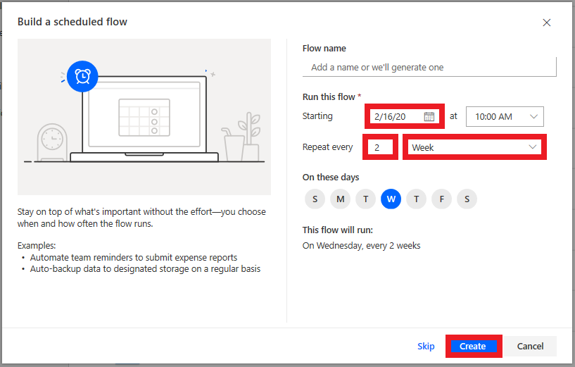
Scheduled flows
Scheduled flows can run:
Once a day, an hour, or a minute
On a date that you specify
After a number of days, hours, or minutes that you specify
Notes:
Create the flow:
For example, if you want the flow to run every two weeks, enter 2 in the Interval field, and select Week in the Frequency field. You can also specify the day of the week your flow should run. The text at the bottom of the dialog box explains your inputs in plain language.
Specify advanced options
For example, set up the flow as shown in the following graphic to start it no earlier than noon (Pacific time) on Monday, January 1, 2018, and to run it every two weeks, at 5:30 PM (Pacific time) on Tuesday.
Use the compose action
Use the Data Operation - Compose (compose) action to save yourself from entering identical data multiple times when you are designing a flow.

Slide 59
Power Virtual Agents

Slide 60
Power Virtual Agents and what can it do for you
Power Virtual Agents can
Empower your teams
Reduce costs
Improve customer satisfaction
Highlights of Power Virtual Agents
Get started in seconds
Empower your subject matter experts.
Enable rich, natural conversations.
Enable chatbots to take action.
Monitor and improve chatbot performance.
Better together.
Notes:
Using Power Virtual Agents, you can:
Empower your teams by allowing them to easily build chatbots themselves without needing intermediaries, coding, or AI expertise.
Reduce costs by easily automating common inquiries and freeing human agent time to deal with more complex issues.
Improve customer satisfaction by allowing customers to self-help and resolve issues quickly, 24/7 using rich personalized bot conversations.
Get started in seconds. Power Virtual Agents is a software-as-a-service (SaaS) offering. It allows you to easily sign up, create your chatbot, and embed it into your website with just a few clicks. There is no infrastructure to maintain or complex systems to deploy.
Empower your subject matter experts. Using Power Virtual Agents, you are in the driver's seat. Your SMEs can create chatbots quickly and easily using a novel, intuitive, code-free graphical interface, eliminating the need for AI expertise or teams of developers.
Enable rich, natural conversations. Microsoft’s powerful conversational AI capabilities enable your end users to have rich multi-turn conversations that quickly guide them to the right solution. And, unlike most products on the market, there is no need to retrain AI models. Simply provide a few short examples of the topic you want the chatbot to handle, build the conversation using the graphical editor, and your chatbot is ready to handle customer requests. You can even try out your changes in real-time in the test pane!
Enable chatbots to take action. Chatbots that can chat with your users are great, but chatbots that can act on their behalf are even better. With Power Virtual Agents, you can easily integrate with services and back-end systems out-of-the-box or through hundreds of easy-to-add custom connectors using Power Automate. This makes it simple to create a chatbot that not only responds to the user, but also acts on their behalf.
Monitor and improve chatbot performance. Power Virtual Agents lets you keep an eye on how your chatbots are performing using powerful metrics and AI-driven dashboards. Easily see which topics are doing well and where the chatbot can improve, and quickly make adjustments to improve performance.
Better together. Power Virtual Agents works hand-in-hand with Dynamics 365 Customer Service Insights to provide a holistic view of your customer service operations. You can use Customer Service Insights and Power Virtual Agents together to determine which topics are trending or consuming support resources, and then easily automate them.
Check out this video for a brief overview of Power Virtual Agents: https://youtu.be/J5i7h4Uzju4 or perform a demo for students*

Slide 61
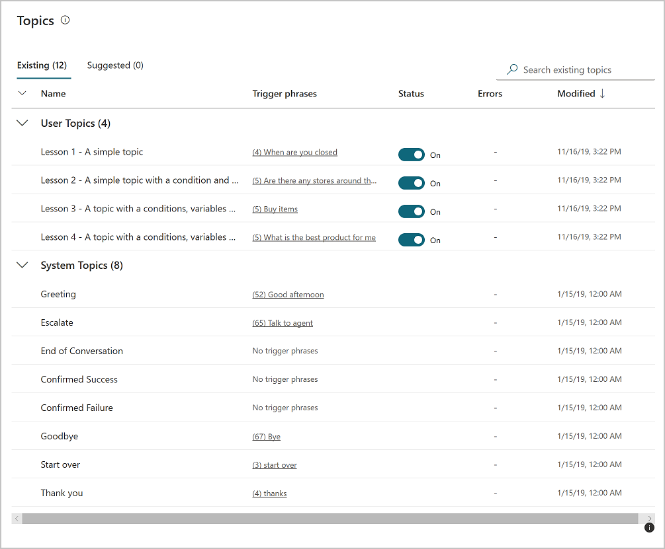
Power Virtual Agents components - Topics
Topics
A topic defines how a chatbot conversation plays out. You can:
Author topics by customizing provided templates
Create new topics from scratch
Get suggestions from existing help sites
Topic types
User Topics
System Topics
Notes:
When you create chatbots with Power Virtual Agents, you author and edit topics. Topics are discrete conversation paths that, when used together within a single chatbot, allow for users to have a conversation with a chatbot that feels natural and flows appropriately.
Topics
In Power Virtual Agents, a topic defines how a chatbot conversation plays out. You can author topics by customizing provided templates, create new topics from scratch, or get suggestions from existing help sites.
A topic has trigger phrases—these are phrases, keywords, or questions that a user is likely to type that is related to a specific issue —and conversation nodes—these are what you use to define how a chatbot should respond and what it should do.
The AI uses natural language understanding to parse what a customer actually types and find the most appropriate trigger phrase or node.
For example, a user might type "Open hours" into your chatbot—the AI will be able to match that to the Store hours topic and begin a conversation that asks which store the customer is interested in, and then display the hours the store is open.
Use system and sample topics
When you create a chatbot, a number of topics will be automatically created for you.
Four prepopulated User Topics that are titled as lessons. These lesson topics can be used to help understand simple to complex ways of using nodes to create chatbot conversations.
A number of System Topics. These are prepopulated topics that you are likely to need during a chatbot conversation. We recommend you keep these and use them until you are comfortable with creating an end-to-end chatbot conversation.
You can edit both of these topic types in the same manner as for topics you create; however, you cannot delete them.

Slide 62
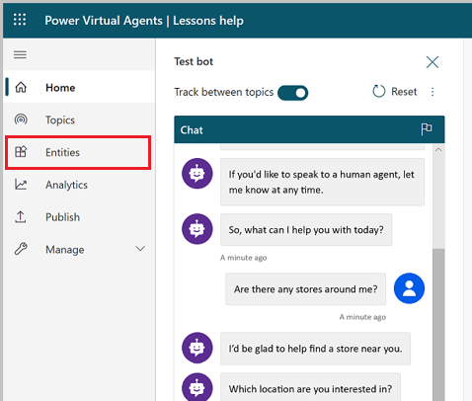
Power Virtual Agents components - Entities
Entities
An entity can be viewed as an information unit that represents a certain type of a real-world subject, like a phone number, zip code, city, or even a person's name.
Entity types
Prebuilt entities
Represents the most commonly used information in real-word dialogs.
Custom entities
Notes:
A big part of chatbot conversations in Power Virtual Agents is natural language understanding, which is the ability for the AI to understand a user's intent. For example, natural language understanding is involved when a user might say "I tried to use my gift card but it doesn't work" and the chatbot is able to route the user to the topic related to gift cards not working—even if that exact phrase isn't listed as a trigger phrase.
One fundamental aspect of natural language understanding is to identify entities in a user dialog. An entity can be viewed as an information unit that represents a certain type of a real-world subject, like a phone number, zip code, city, or even a person's name.
Custom entities: The prebuilt entities cover commonly used information types, but on some occasions, such as when building a chatbot that serves a specific purpose, you will need to teach the chatbot's language understanding model some domain-specific knowledge.

Slide 63
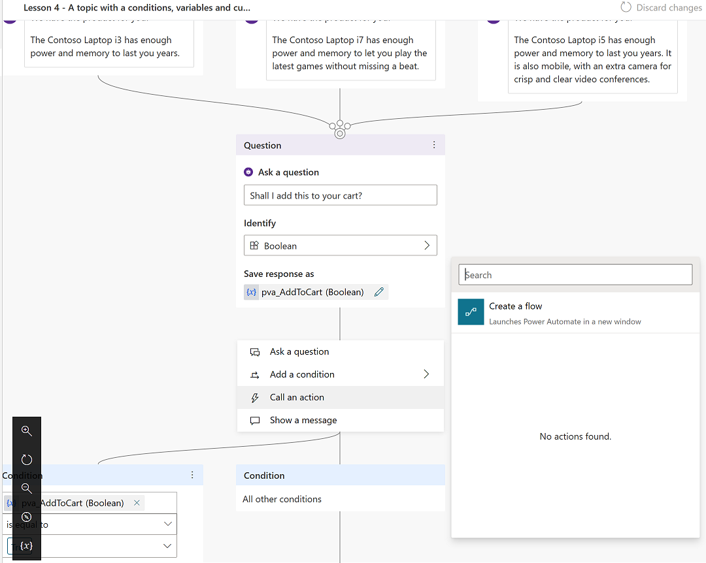
Power Virtual Agents components - Actions
Actions
Enable your chatbot to perform an action by calling a Microsoft Power Automate flow. You can:
Call flows from within topics.
Utilize flows that have already been created in your Power Apps environment.
Create a flow from within the Power Virtual Agents authoring canvas.
Notes:
Flows can help you automate activities or call backend systems. For example, you can use flows with end-user authentication to retrieve information about a user after they sign in.
You can call flows from within topics, as a discrete Call an action node. You can utilize flows that have already been created in your Power Apps environment, or you can create a flow from within the Power Virtual Agents authoring canvas.
Flows typically use variables to input and output information. The variables can then be used in other nodes within the topic.

Slide 64
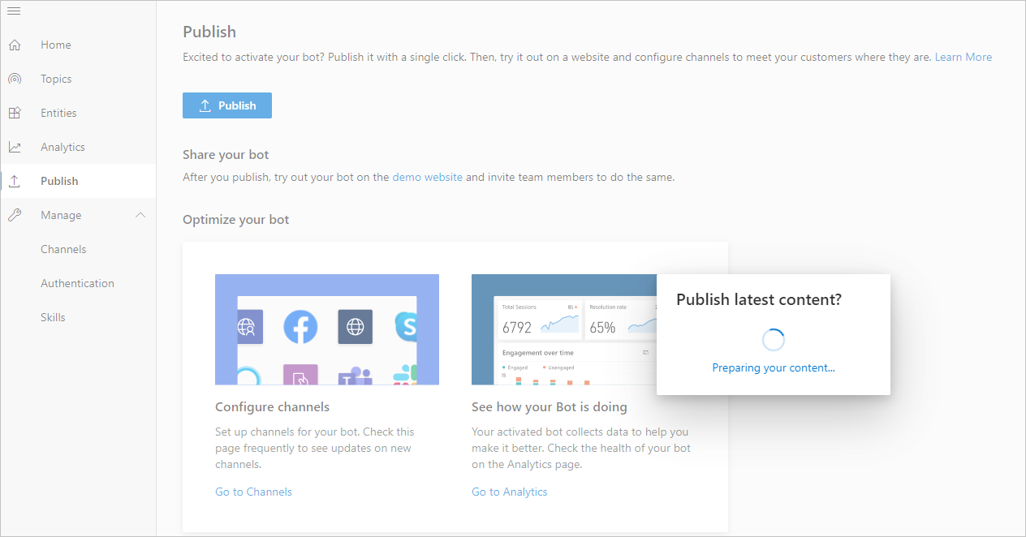
Power Virtual Agents components - Publishing
Publishing
Publish chatbots to engage with your customers on multiple platforms or channels.
Platforms or channels include:
Websites
Mobile app
Facebook
Microsoft Teams
Skype
Cortana
Slack
etc.
Notes:
You can also configure a Power Virtual Agents chatbot to provide authentication capabilities, so users can sign in with any OAuth2 identity provider, such as Azure Active Directory (Azure AD), a Microsoft account, or Facebook.
After you have published at least once, you can connect your chatbot to additional channels.

Slide 65
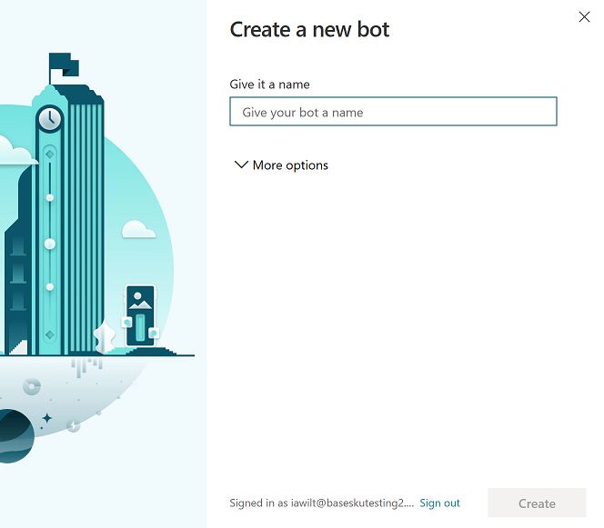
Create a chatbot
Create a new bot
Go to https://aka.ms/TryPVA
Select Start Free, and then sign in with your work email address
Choose a name for your chatbot
Select Create
Other operations
Create additional chatbots.
Delete a chatbot.
Notes:
If you do not have a Power Virtual Agents set up already, go to https://aka.ms/TryPVA in your browser to begin. Supported browsers include Microsoft Edge, Chrome, and Firefox. On the website, select Start Free, and then sign in with your work email address. Note that personal Microsoft accounts are not currently supported.
Create a new bot
1. Next, you’ll choose a name for your chatbot. This can be something generic to your company or specific to the scenario you are tailoring your chatbot to.
Your chatbot is created in the default Power Apps environment that was created for you when you signed up. For most users, this is sufficient. However, if you want to specify a custom Power Apps environment for your Power Virtual Agents, you can do so by expanding the More options menu and selecting a different environment.
2. Once you select Create, the process of creating the first chatbot within a new environment can take up to 15 minutes. Subsequent bots will be created much faster.
3. After a few minutes, you’ll land on the home page and have an opportunity to play around with the chatbot in read-only mode. You can't save any edits during this time, but you can explore the overall user interface, look at the topics, experiment with the preloaded User Topics and System Topics, and interact with your chatbot using the Test Canvas.
4. When the chatbot creation process completes, the banner changes. You now have full functionality in the chatbot and can modify any User or System topic, test out your content changes, or deploy your bot.
Create additional chatbots
If you have already created a chatbot, you can create a new chatbot by selecting the icon on the title bar to open the Bots pane and then selecting New bot.
Delete a chatbot
You can delete chatbots to remove them from your environment.
Select the chatbot icon on the top menu bar, and then select the chatbot you want to delete.
Select the Settings icon on the top menu bar, then select General settings.
Select Delete bot.
You'll be asked to confirm the deletion of the bot, after which all chatbot content is immediately deleted.
If your license has expired, you can delete your chatbot(s) by selecting Permanently delete your bots.

Slide 66
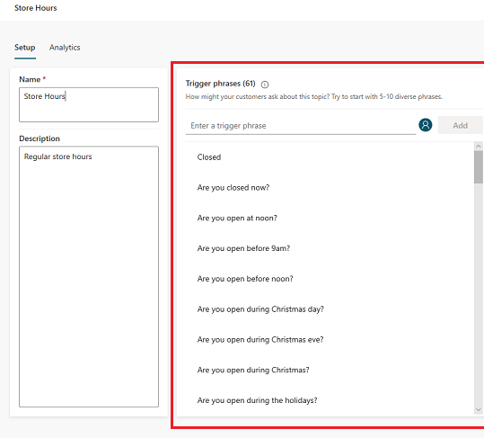
Create a topic
Create a topic
Go to Topics tab.
Select New topic.
Specify a name, description, and one or more trigger phrases for the topic.
Notes:
As mentioned earlier, a topic defines how a chatbot conversation plays out in Power Virtual Agents
Create a topic
Go to the Topics tab on the side navigation pane to open the Topics page.
On the topics page, select New topic.
Specify a name, description, and one or more trigger phrases for the topic. (A trigger phrase is a phrase that a customer enters in the chat window to start a conversation with the bot. Once the conversation is started, the conversation follows the path you define. You can specify more than one trigger phrase for a topic. You can include punctuation in a trigger phrase, but it is best to use short phrases rather than long sentences.)
Select Save topic to add the topic to the topics list.

Slide 67
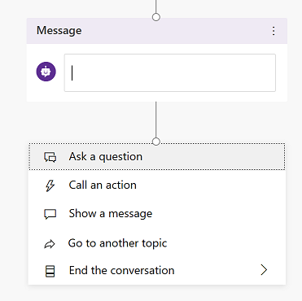
Work with topics
Design the topic’s conversation path
Insert nodes into the conversation path
Ask a question
Call an action
Show a message
Go to another topic
End the conversation
Branch based on a condition
Delete nodes
Notes:
Design the topic's conversation path
In the topic details for the topic you want to edit, select Go to authoring canvas.
Power Virtual Agents opens the topic in the authoring canvas and displays the topic's trigger phrases. The authoring canvas is where you define the conversation path between a customer and the bot.
Insert nodes
When adding a node, you can choose from five options. Each option has a specific node or nodes that will be inserted into the conversation path.
Ask a question
To have the chatbot ask a question and get a response from the user, select + to add a node, and then Ask a question to add a new Question node
Enter the question phrase in the first text box, Ask a question.
You can choose from several options for the user’s response in the Identify field.
Depending on what you choose in the Identify field, you can enter what options the user should have.
You can save the user response in a variable to be used later
Call an action
You can call Power Automate flows by selecting Call an action
Show a message
To specify a response from the bot, select + to add a node, and then Show a message to add a new Message node.
Enter what you want the chatbot to say in the text box. You can apply some basic formatting, such as bold, italics, and numbering
Go to another topic
To automatically have the chatbot move to a separate topic, select + to add a node, and then Go to another topic.
End the conversation
When you end the conversation, you can have a survey appear that asks the user if their question or issue was answered or resolved correctly. This information is collected under the customer satisfaction analytics page.

Slide 68
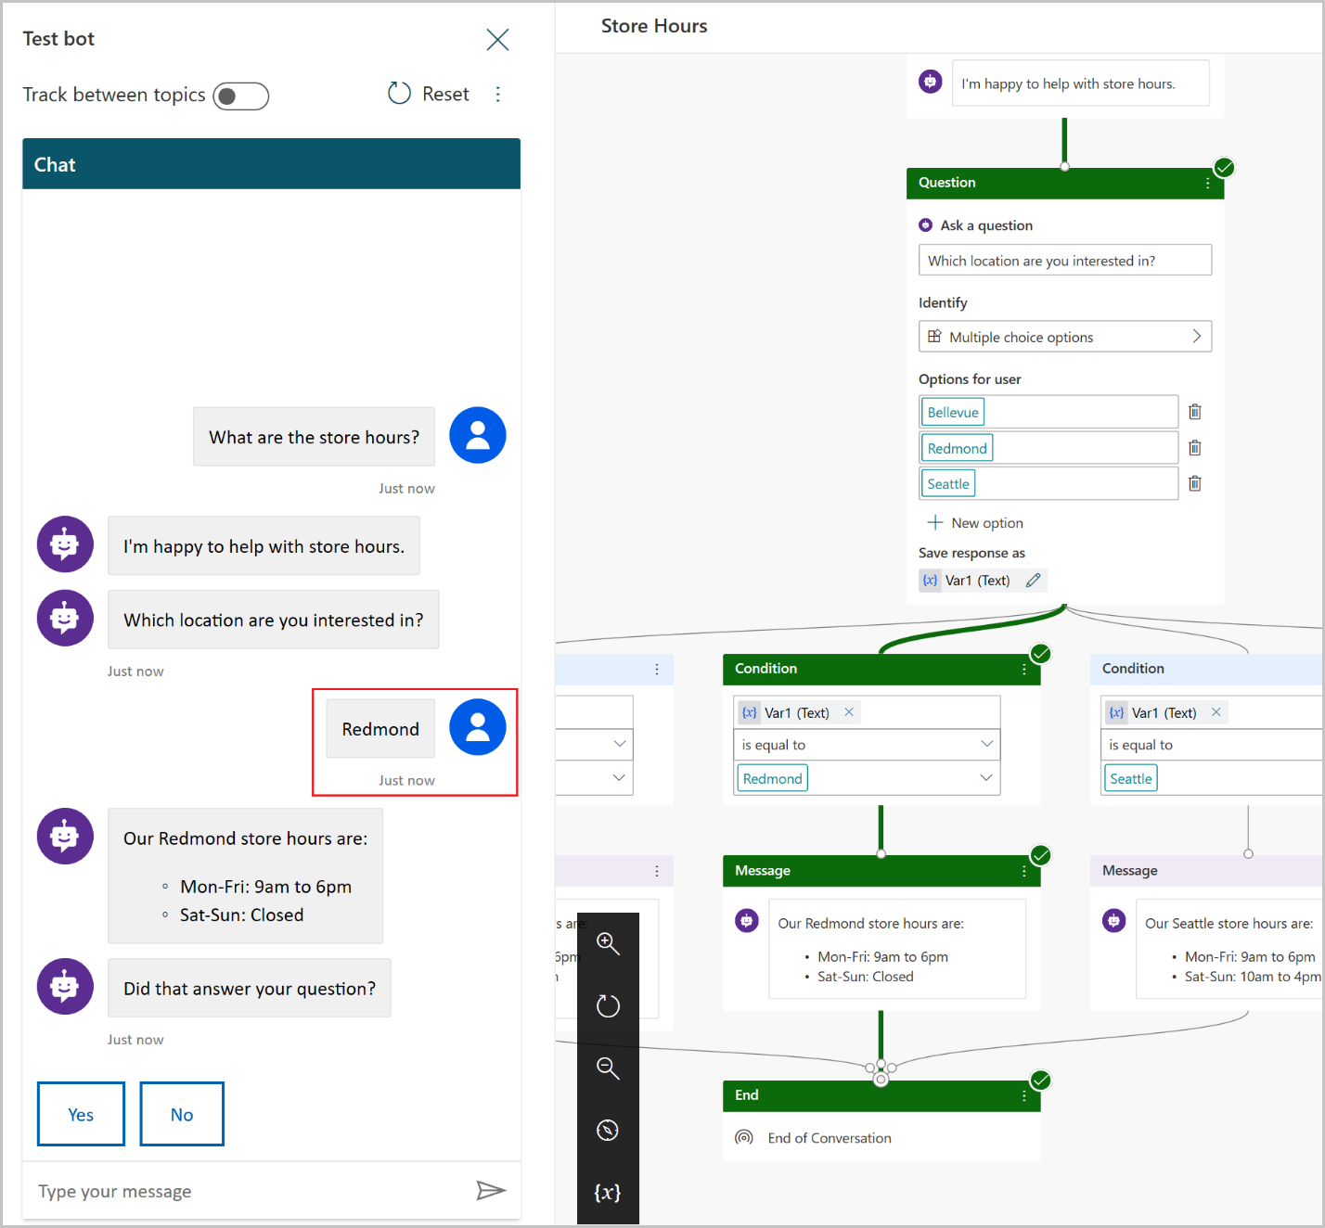
Test a chatbot
Test a topic in the Test bot pane
Select Test your bot
Click Reset at top of Test bot pane
Enter a trigger phrase for the topic
Test it flows as designed in the topic
Revise conversation path in Authoring canvas
Track through the topic’s conversation path
Set Track between topics to On
Notes:
As you design your chatbot in Power Virtual Agents for Customer Service, you can use the Test bot pane to see how the chatbot leads a customer through the chatbot conversation.
To help you find and fix unexpected behavior, you can enable tracking between topics to take you through the chatbot conversation step-by-step, and go to the corresponding node in the authoring canvas.
Track through the topic's conversation path
As you fine-tune your bot, it can be useful to enable tracking between topics so you can follow through the conversation path step by step.
If the Test bot pane is hidden, open it by selecting Test your bot.
At the top of the Test bot pane, set Track between topics to On.
Enter a trigger phrase for the topic you want to check, and then continue testing the conversation.
As you move through the conversation in the Test bot pane, the authoring canvas highlights the current place in the conversation path. The authoring canvas displays highlighted nodes in green.
To navigate to an earlier place in the conversation path in the authoring canvas, select it in the Test bot pane.

Slide 69
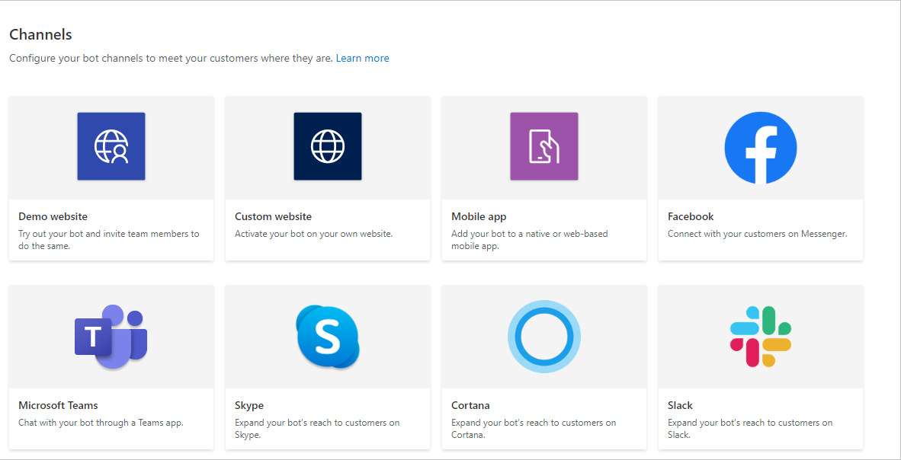
Publish a chatbot
Publish the latest chatbot content:
Go to the Publish tab on the side navigation pane.
Select Publish.
Configure channels:
After publishing your bot at least once, you can add channels to make the bot reachable by your customers.
Notes:
With Power Virtual Agents, you can publish chatbots to engage with your customers on multiple platforms or channels. These include live websites, mobile apps, and messaging platforms like Microsoft Teams and Facebook.
After you have published at least once, you can connect your chatbot to additional channels.
Each time you want to update your chatbot, you publish it again from within the Power Virtual Agents app itself. This will update the chatbot across all the channels where you have inserted or connected your chatbot.
Publish the latest chatbot content
You need to publish the chatbot at least once before your customers can interact with it or you can share it with your teammates.
After the first publish, you can do subsequent publishes whenever you would like your customers to engage with the latest chatbot content.
Configure channels
After publishing your bot at least once, you can add channels to make the bot reachable by your customers. You can see what channels we currently support by selecting Manage and going to the Channels tab in the side navigation pane.

Slide 70
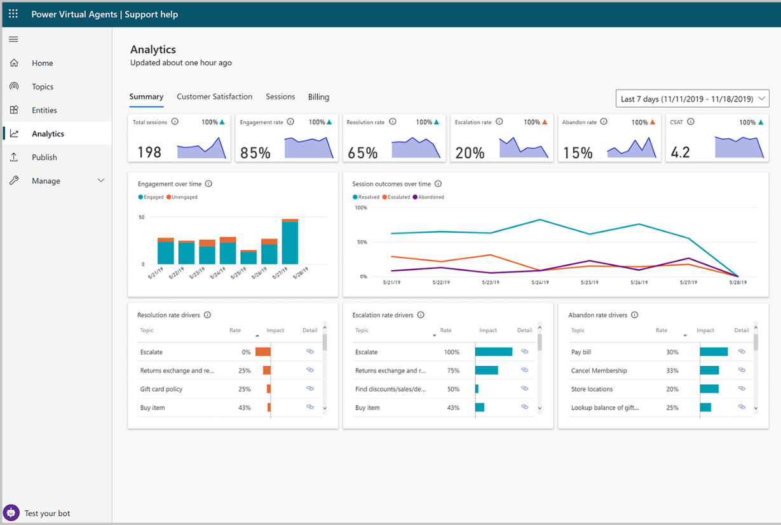
Analyzing a chatbot
View analytics
Engagement over time chart
Session outcomes over time chart
Resolution rate drivers chart
Escalation rate drivers chart
Abandon rate drivers chart
View billed sessions for chatbots
The billed session begins when a user topic is triggered.
Find the number of billed sessions for your bot
Notes:
Power Virtual Agents has a comprehensive set of analytics that show you the key performance indicators for your bot.
Multiple charts show you trends and usage for your chatbot's topics. These charts use AI to highlight the topics that have the greatest impact on your chatbot’s performance.
Analytics in Power Virtual Agents
The analytics section is divided into a number of pages to give you multiple ways to understand bot performance.
View billed sessions for Power Virtual Agents
When you purchase a Power Virtual Agents license, you gain capacity for the specified number of billed sessions. Power Virtual Agents pools this capacity across the entire tenant.
The consumption of the capacity isn't reported at the tenant level, but can be seen for each individual bot.
Find the number of billed sessions for your bot
In Power Virtual Agents, select Analytics from the side navigation pane.
Go to the Billing tab.

Slide 71
Power BI

Slide 72

What is Power BI?
Self-service platform that helps you discover, analyze and visualize data in order to share and collaborate insights with your colleagues
Visualizations are interactive and scalable reports, based on collections of different data sources
https://dpspowerbi.blob.core.windows.net/powerbi-prod-media/powerbi.microsoft.com/en-us/documentation/articles/powerbi-learning-0-0-what-is-power-bi/20160929090613/c0a0_1.png
Notes:
Microsoft Power BI is a collection of software services, apps, and connectors that work together to turn your unrelated sources of data into coherent, visually immersive, and interactive insights.
Whether your data is a simple Microsoft Excel workbook, or a collection of cloud-based and on-premises hybrid data warehouses, Power BI lets you easily connect to your data sources, clean, and model your data without affecting the underlying source, visualize (or discover) what's important, and share that with anyone or everyone you want.

Slide 73
What is Power BI? - continued
Power BI concepts
Capacities:
Set of resources used to host and deliver content
Either shared or dedicated
Workspaces:
My workspace is for personal use
Workspaces are for collaboration and sharing
Datasets:
A collection of data that you import or connect to
Associated with workspaces
Shared Datasets:
Used to share optimized and accurate data
Provides data consistency to organizations
Reports:
One or more pages of visualizations
Two modes: Reading view & editing view
Dashboards:
Single canvas containing tiles and widgets
Easy viewing and monitoring
Notes:
Capacities
Capacities are a core Power BI concept representing a set of resources used to host and deliver your Power BI content. Capacities are either shared or dedicated. A shared capacity is shared with other Microsoft customers, while a dedicated capacity is fully committed to a single customer. Dedicated capacities require a subscription. By default, workspaces are created on a shared capacity.
Workspaces
Workspaces are containers for dashboards, reports, datasets, and dataflows in Power BI. There are two types of workspaces: My workspace and workspaces.
My workspace is the personal workspace for any Power BI customer to work with your own content. Only you have access to your My workspace. You can share dashboards and reports from your My Workspace. If you want to collaborate on dashboards and reports, or create an app, then you want to work in a workspace.
Workspaces are used to collaborate and share content with colleagues. You can add colleagues to your workspaces and collaborate on dashboards, reports, and datasets. With one exception, all workspace members need Power BI Pro licenses.
Workspaces are also the places where you create, publish, and manage apps for your organization. Think of workspaces as staging areas and containers for the content that will make up a Power BI app. So what is an app? An app is a collection of dashboards and reports built to deliver key metrics to the Power BI consumers in your organization. Apps are interactive, but consumers cannot edit them. App consumers, the colleagues who have access to the apps, do not necessarily need Pro licenses.
Datasets
A dataset is a collection of data that you import or connect to. Power BI lets you connect to and import all sorts of datasets and bring all of it together in one place. Datasets can also source data from dataflows.
Shared Datasets
Business intelligence is a collaborative activity. It's important to establish standardized datasets that can be the 'one source of truth.' Discovering and reusing those standardized datasets is key. When expert data modelers in your organization create and share optimized datasets, report creators can start with those datasets to build accurate reports. Your organization can have consistent data for making decisions, and a healthy data culture.
Reports
A Power BI report is one or more pages of visualizations such as line charts, maps, and treemaps. Visualizations are also called visuals. You can create reports from scratch within Power BI, import them with dashboards that colleagues share with you, or Power BI can create them when you connect to datasets from Excel, Power BI Desktop, databases, and SaaS applications.
When you open a report, it opens in Reading view. If you have edit permissions, then you see Edit report in the upper-left corner, and you can view the report in Editing view.
When you open a workspace, the associated reports are listed under the Reports tab. Each listed report represents one or more pages of visualizations based on only one of the underlying datasets. To open a report, select it.
When you open an app, you are presented with a dashboard. To access an underlying report, select a dashboard tile (more on tiles later) that was pinned from a report. Keep in mind that not all tiles are pinned from reports, so you may have to click a few tiles to find a report.
Dashboards
A dashboard is something you create in the Power BI service or something a colleague creates in the Power BI service and shares with you. It is a single canvas that contains zero or more tiles and widgets. Each tile pinned from a report or from Q&A displays a single visualization that was created from a dataset and pinned to the dashboard. Entire report pages can also be pinned to a dashboard as a single tile. There are many ways to add tiles to your dashboard; too many to be covered in this overview topic.

Slide 74
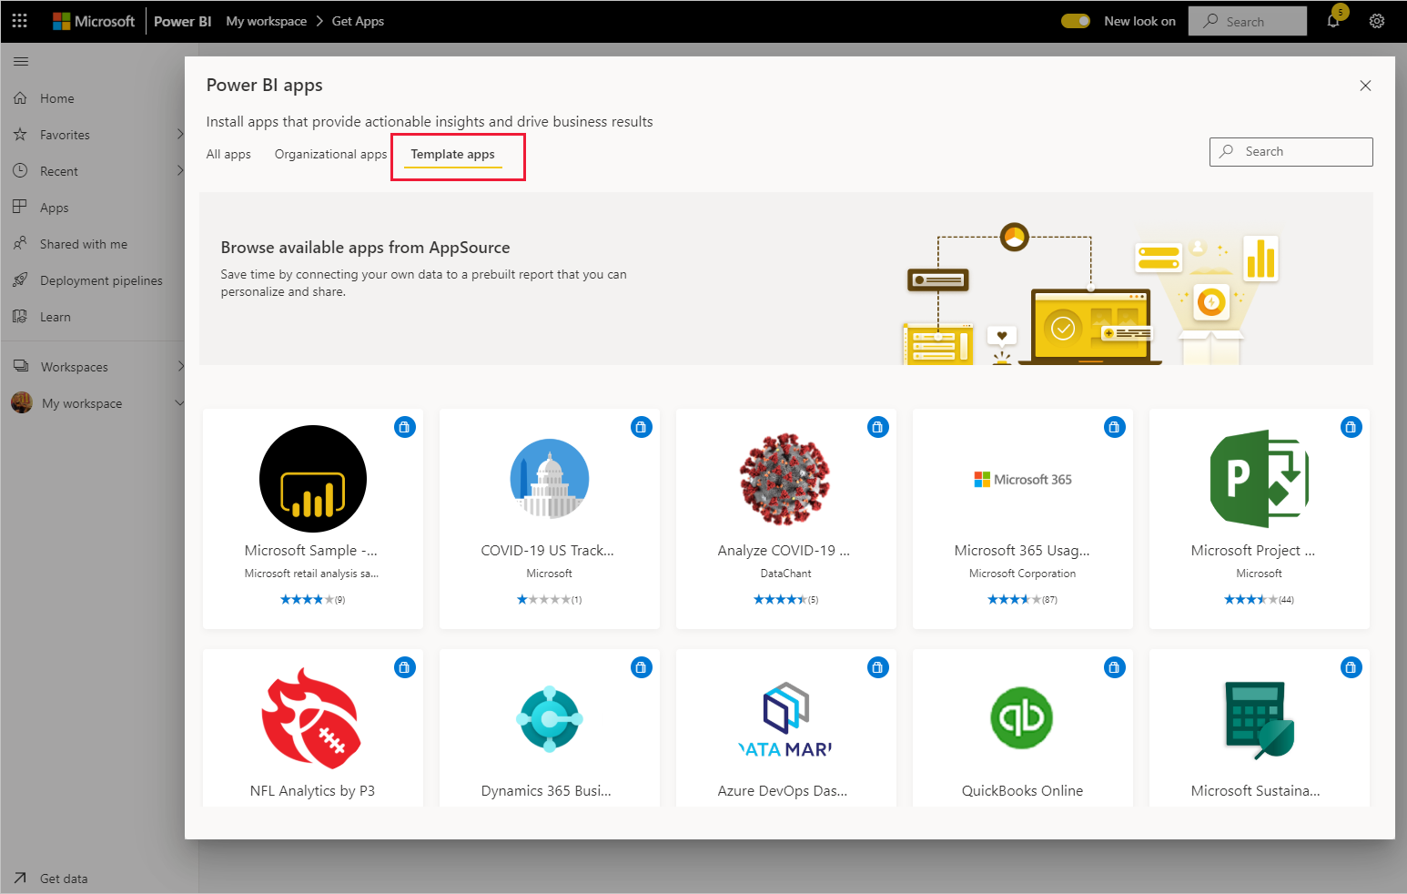
Template Apps
Definition
The new Power BI template apps enable Power BI partners to build Power BI apps with little or no coding and deploy them to any Power BI customer.
As a Power BI partner, you create a set of out-of-the-box content for your customers and publish it yourself.
You can build template apps that allow your customers to connect within their own accounts.
Notes:
Install a template app:
In the nav pane in the Power BI service, select Apps > Get apps.
In the Power BI apps marketplace that appears, select Template apps. All the template apps available in AppSource will be shown. Browse to find the template app you're looking for, or get a filtered selection by using the search box.
When you find the template app you're looking for, click it. The template app offer will display. Click GET IT NOW.
In the dialog box that appears, select Install.

Slide 75
Power BI Tools
Desktop
Mobile
Service
Notes:
Connect to sources
Prepare data sets for analysis
Transform and Cleanse
Create reports for consumption

Slide 76
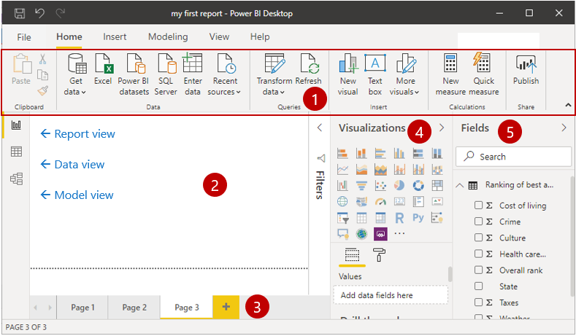
Data modeling and visualizations
In Power BI Desktop, you will begin to build reports in the Report view. You will be working in five main areas:
Ribbon
Report view, or canvas
Pages tab
Visualizations pane
Fields pane
Notes:
Ribbon - Displays common tasks that are associated with reports and visualizations.
Report view, or canvas - Where visualizations are created and arranged.
The Data view allows you to view all of your data available in your report. This is an easy way to quickly check data types and validate data.
The Model view allows you to visually set the relationship between tables or elements. A relationship is where two or more tables are linked together because they contain related data. This enables users to run queries for related data across multiple tables.
Pages tab - Located along the bottom of the page, this area is where you would select or add a report page.
Visualizations pane - Where you can change visualizations, customize colors or axes, apply filters, drag fields, and more.
Fields pane - Where query elements and filters can be dragged onto the Report view or dragged to the Filters area of the Visualizations pane.

Slide 77
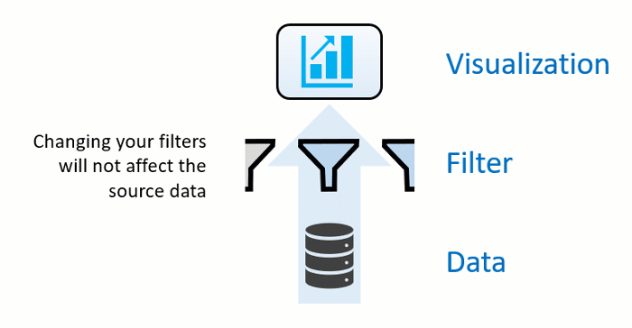
Filter data with Power BI
Slicers:
A simple type of filtering that you can use directly on the report page. Slicers provide cues to ways you can filter the results in the visuals on a report page.
Four types of filters:
Report
Page
Visual
Drillthrough
Notes:
Power BI offers several ways to filter and highlight reports. Knowing how to filter data is the key to finding the right information.
Note:
Filtering only applies to reports, not to dashboards.
When you filter a visual like a bar chart, you are just changing the view of the data in that visual. You are not modifying the source data in any way.
Slicers
There are several different types of slicers: numeric, categorical, and date. Slicers make it easy to filter all the visuals on the page at once.
The four types of filters are:
Report – Applies to all pages in the report.
Page – Applies to all the visuals on the current report page.
Visual – Applies to a single visual on a report page. You only see visual level filters if you have selected a visual on the report canvas.
Drillthrough – Allows you to explore successively more detailed views within a single visual.

Slide 78
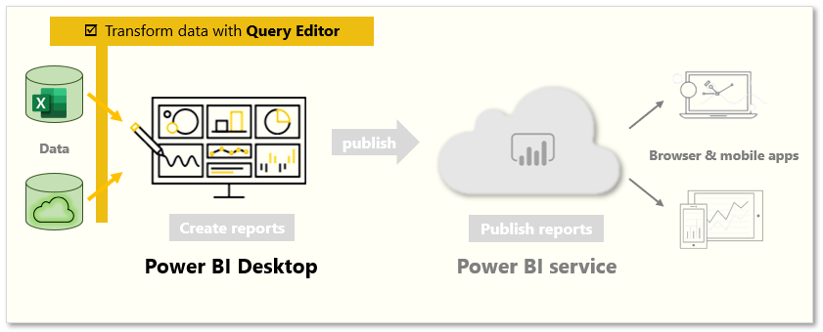
Transform data
Launch Power Query Editor
Select Edit from the Navigator window
Using the Edit Queries button on the Home ribbon from Power BI Desktop
How to transform data
On the center pane, right-clicking a column displays the available transformations
Notes:
Sometimes, your data might contain extra data or have data in the wrong format. Power BI Desktop includes the Power Query Editor tool, which can help you shape and transform data so that it's ready for your models and visualizations.
Launch Power Query Editor
To begin, select Edit from the Navigator window to launch Power Query Editor. You can also launch Power Query Editor directly from Power BI Desktop by using the Edit Queries button on the Home ribbon.
After loading your data into Power Query Editor
In the ribbon, the active buttons enable you to interact with the data in the query.
On the left pane, queries (one for each table, or entity) are listed and available for selecting, viewing, and shaping.
On the center pane, data from the selected query is displayed and available for shaping.
The Query Settings window lists the query’s properties and applied steps.
How to transform data
On the center pane, right-clicking a column displays the available transformations. Examples of the available transformations include removing a column from the table, duplicating the column under a new name, or replacing values. From this menu, you can also split text columns into multiples by common delimiters.
The Power Query Editor ribbon contains additional tools that can help you change the data type of columns, add scientific notation, or extract elements from dates, such as day of the week.
Tips:
If you make a mistake, you can undo any step from the Applied Steps list.
As you apply transformations, each step appears in the Applied Steps list on the Query Settings pane. You can use this list to undo or review specific changes, or even change the name of a step. To save your transformations, select Close & Apply on the Home tab.

Slide 79
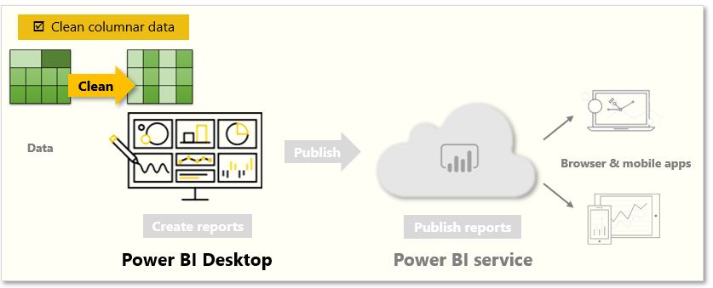
Clean data
How to clean data
Clean columnar data with Power Query Editor
Transpose data
Transpose is used to swap rows into columns to better format the data.
Format data
With some transformations, you'll cleanse data into a dataset that you can use in Power BI
Notes:
While Power BI can import your data from almost any source, its visualization and modeling tools work best with columnar data. Sometimes, your data won't be formatted in simple columns, which is often the case with Excel spreadsheets.
How to clean data
Fortunately, Power Query Editor has tools to help you quickly transform multi-column tables into datasets that you can use.
Transpose data
By using Transpose in Power Query Editor, you can swap rows into columns to better format the data.
Format data
You might need to format data so that Power BI can properly categorize and identify that data. With some transformations, you'll cleanse data into a dataset that you can use in Power BI. Examples of powerful transformations include promoting rows into headers, using Fill to replace null values, and Unpivot Columns.
With Power BI, you can experiment with transformations and determine which will transform your data into the most usable columnar format. Remember, the Applied Steps section of Power Query Editor records all your actions. If a transformation doesn't work the way that you intended, select the X next to the step, and then undo it.
After you've cleaned your data into a usable format, you can begin to create powerful visuals in Power BI.
For more information, see Tutorial: Combine sales data from Excel and an OData feed .

Slide 80
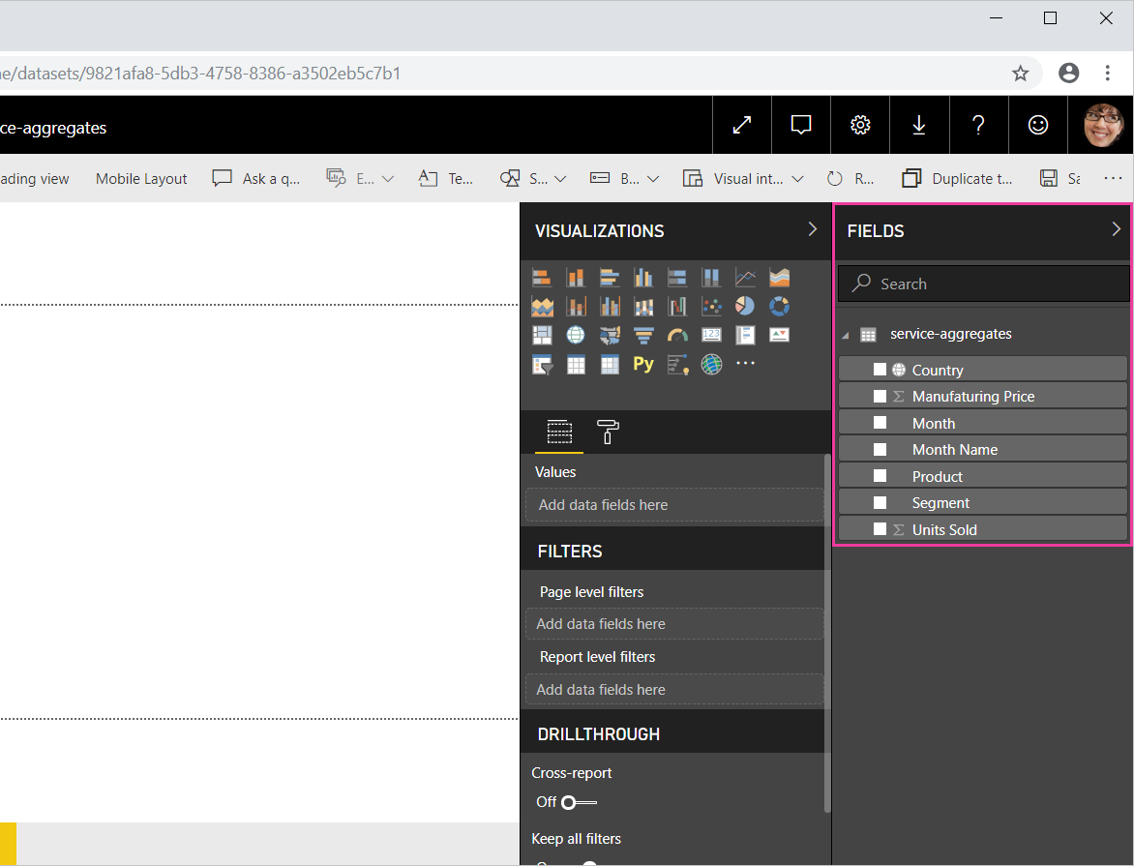
Work with aggregates in the Power BI service
When you combine values in your data, it's called aggregating. The result of that mathematical operation is an aggregate.
Ways to aggregate your data
- Do Not Summarize
- Sum
- Average
- and more
Notes:
What is an aggregate?
Sometimes you want to mathematically combine values in your data. The mathematical operation could be sum, average, maximum, count, and so on. When you combine values in your data, it's called aggregating. The result of that mathematical operation is an aggregate.
When Power BI service and Power BI Desktop create visualizations, they may aggregate your data. Often the aggregate is just what you need, but other times you may want to aggregate the values in a different way. For example, a sum versus an average. There are several different ways to manage and change the aggregate Power BI uses in a visualization.
First, let's take a look at data types because the type of data determines how, and whether, Power BI can aggregate it.
Why don't aggregates work the way I want them to?
Working with aggregates in Power BI service can be confusing. Maybe you have a numeric field and Power BI won't let you change the aggregation. Or maybe you have a field, like a year, and you don't want to aggregate it, you just want to count the number of occurrences.
Typically, the underlying issue is the field definition in the dataset. Maybe the dataset owner defined the field as text and that explains why Power BI can't sum or average it. Unfortunately, only the dataset owner can change the way a field is categorized . So if you have owner permissions to the dataset, either in Desktop or the program used to create the dataset (for example, Excel), you can fix this problem. Otherwise, you'll need to contact the dataset owner for help.

Slide 81
Security and Administration
Security: Power BI is built on Azure. This is Microsoft's cloud computing infrastructure and platform, which ensures the same level of security for Power BI as other Microsoft services. Users sign in with their credentials held in Azure Active Directory and control the level of sharing for every report, data or dashboard, determining whether recipients can edit or only view items.
Administration: Power BI administration is the management of a Power BI tenant, including the configuration of governance policies, usage monitoring, and provisioning of licenses, capacities, and organizational resources.
Notes:
Security is at the forefront of data concerns. Administration is at the forefront of business concerns. Thankfully, Power BI's structure and capabilities make both simple to business users and administrators to provide peace of mind.
Power BI is designed for self-service business intelligence. The administrator is the guardian of data, processes, and policies in the Power BI tenant. A Power BI administrator is a key member of a team that includes BI developers, analysts, and other roles. The administrator can help support an organization to make sure that critical goals are met.

Slide 82
Transform data
Create new calculated column
Hide unnecessary columns
Explore edit queries, report building, and relationship tabs
Notes:
Data doesn't always come into your report clean, or ready to use. You may need additional columns or to rename or hide existing columns. You may have multiple data sources and need to define a relationship between them. All of these tasks are known as data transformation.
Instructions: https://docs.microsoft.com/en-us/learn/modules/build-simple-dashboard/3-transform-data

Slide 83
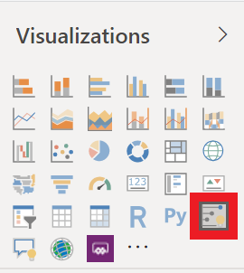
Visualize data
Drag field names from Fields pane and drop into report canvas
In Visualizations pane, select type of visualization you want to create
Notes:
Two ways to create a new visualization in Power BI Desktop are:
Drag field names from the Fields pane and then drop them on the report canvas. By default, your visualization appears as a table of data.
In the Visualizations pane, select the type of visualization that you want to create. With this method, the default visual is a blank placeholder that resembles the type of visual that you selected.
Now that we've learned how to craft simple visuals, go ahead and create a few more to test your new skills and better learn how Power BI works. Finally, save your report locally and select Publish on the Home tab. You can publish this to My Workspace, which is the default for all new accounts. This step is necessary in order to create a dashboard. Once you have published your report, you will have the option to open your report in Power BI, go ahead and do so.
Instructions: https://docs.microsoft.com/en-us/learn/modules/build-simple-dashboard/4-visualize-data

Slide 84
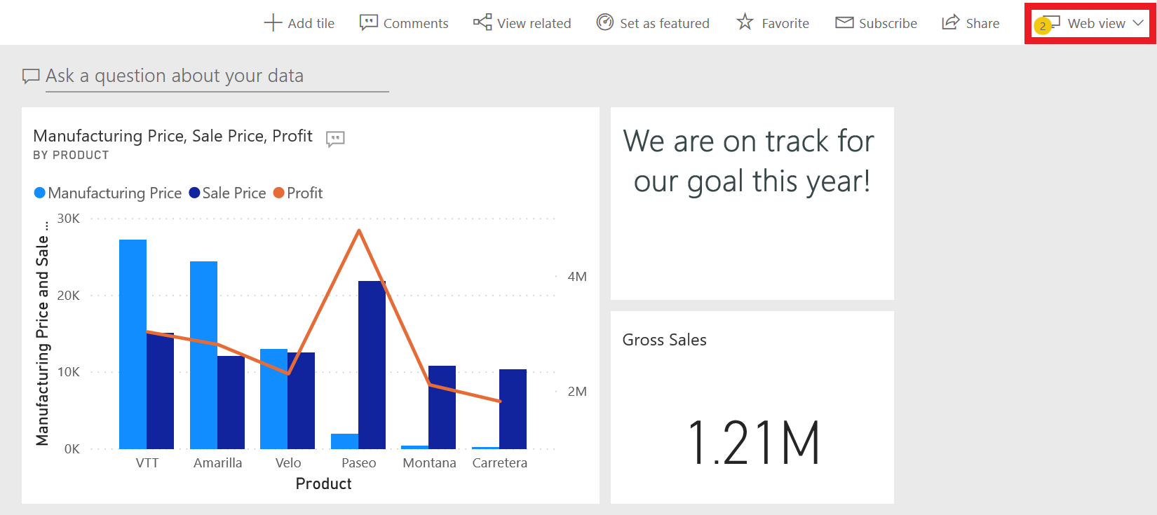
Build a dashboard
Dashboard:
One-page visualization created from within Power BI service (online)
Pin visuals from reports to create dashboards
Notes:
Up to this point we have been working in Power BI Desktop. Dashboards in Power BI are one-page collections of visualizations that are created from within the Power BI service (online). You can create dashboards by pinning visuals from reports.
If you clicked on the link from publishing your report, your report should now be open in your browser. Let's use this report to create a dashboard.
Instructions: https://docs.microsoft.com/en-us/learn/modules/build-simple-dashboard/5-build-dashboard

Slide 85
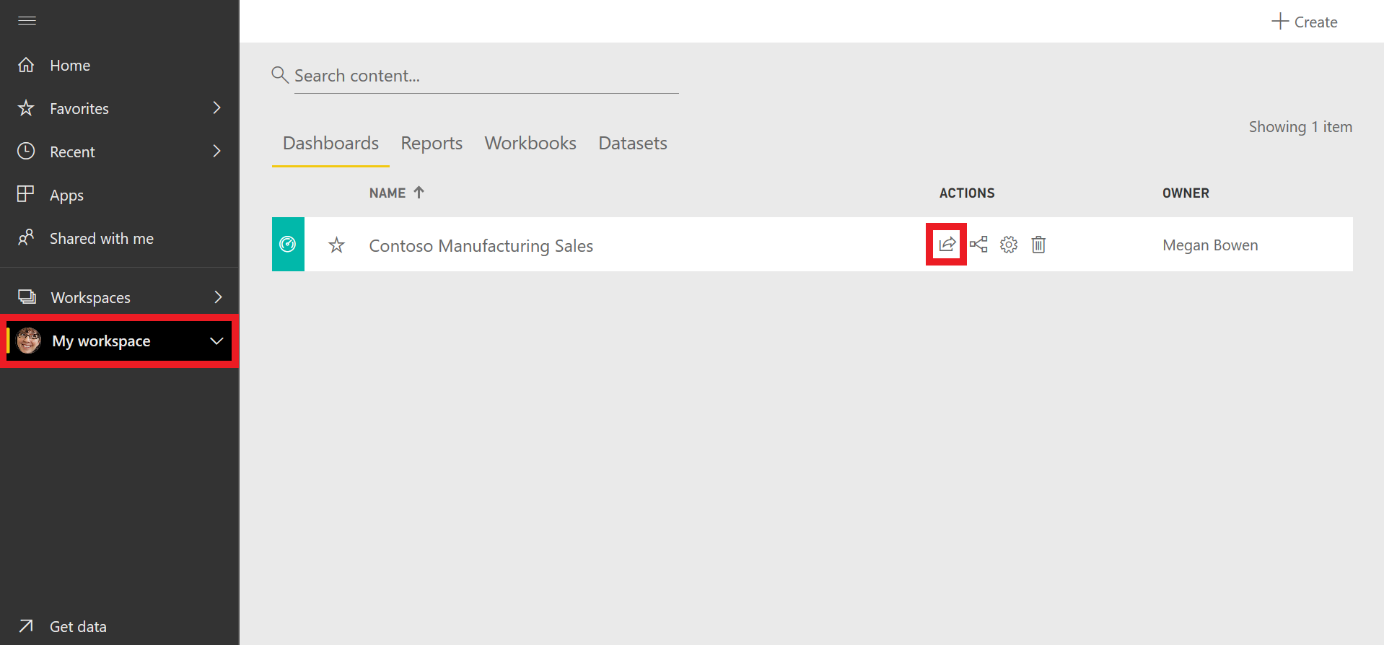
Collaborate and share
Tip:
If you are unable to share with a colleague, you may need to check you and your colleague’s licensing.
Notes:
Students will probably not be able to do this step. It is good to highlight why – licensing. They need Power BI Pro licenses to do this.
Power BI service makes it easy to share your datasets, dashboards, and reports with your colleagues. Power BI simplifies collaboration and improves the outcome by allowing you and your colleagues to work simultaneously on the same dashboards and reports. And, while you and your colleagues explore the data and make changes to the reports and dashboards, the underlying data is not affected.
Instructions: https://docs.microsoft.com/en-us/learn/modules/build-simple-dashboard/6-collaborate-share

Slide 86
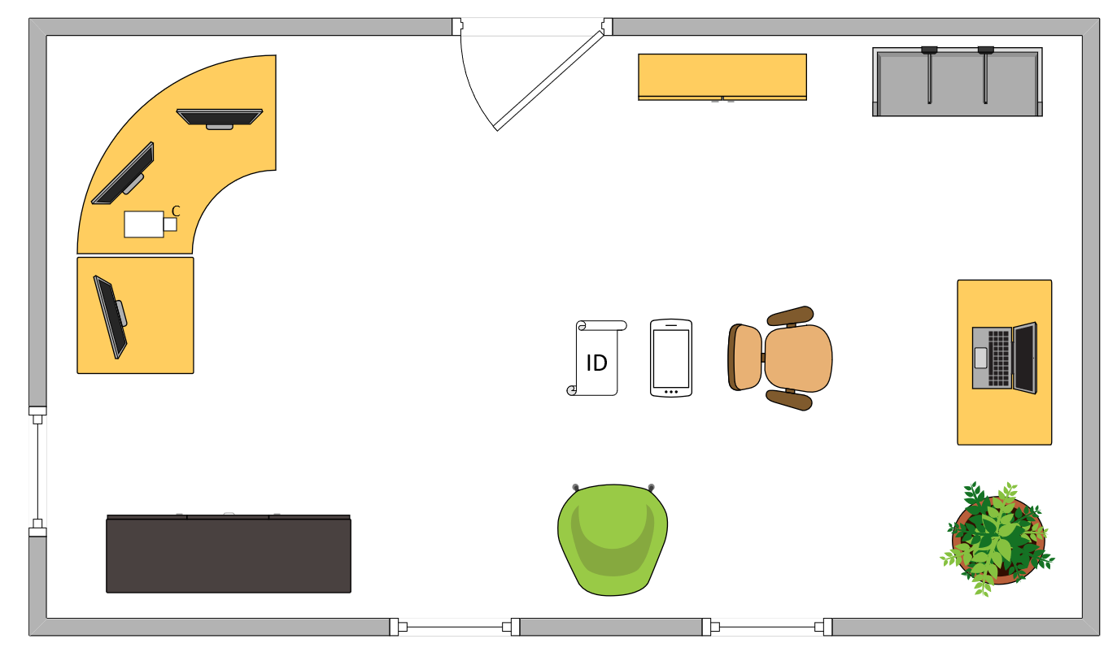

Tim’s Ideal Testing Room
No interruptions or bio breaks
Cover monitors and cameras
Pull back for environment photos
Clear table with laptop

Slide 87
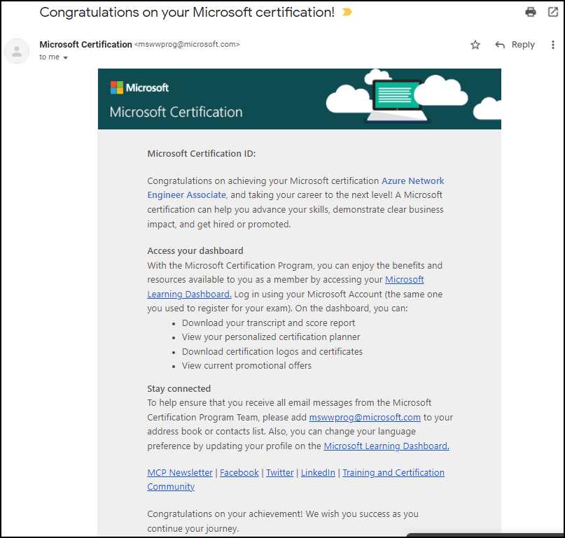
Congratulations!

Slide 88
Exam PL-900 Item Types

Slide 89

Single Answer Multiple Choice

Slide 90

Multiple Answer Multiple Choice

Slide 91
Repeated Scenario
You need to move an Azure VM to another hardware host.
Solution: You redeploy the VM.
Does this solution meet the goal?
Yes
No

Slide 92
Repeated Scenario
You need to move an Azure VM to another hardware host.
Solution: You enable boot diagnostics.
Does this solution meet the goal?
Yes
No

Slide 93

Select and Place

Slide 94
Microsoft Online Testing

Slide 95
Microsoft Online Testing Process
timw.info/online

Slide 96
PL-900 Practice Questions

Slide 97
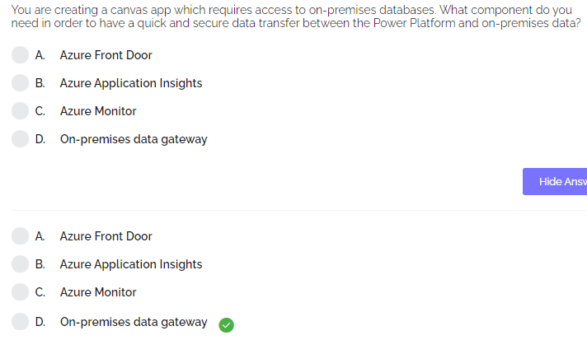

Practice Question

Slide 98
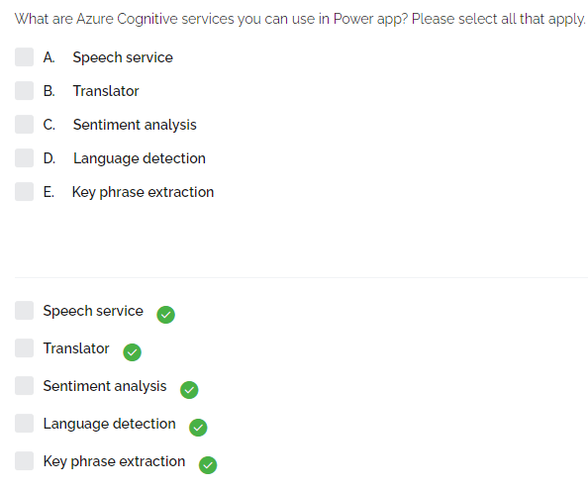
Practice Question

Slide 99
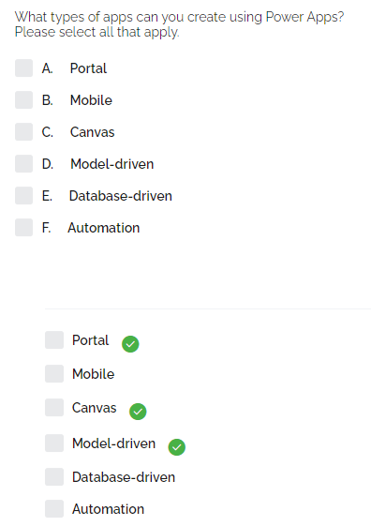
Practice Question

Slide 100
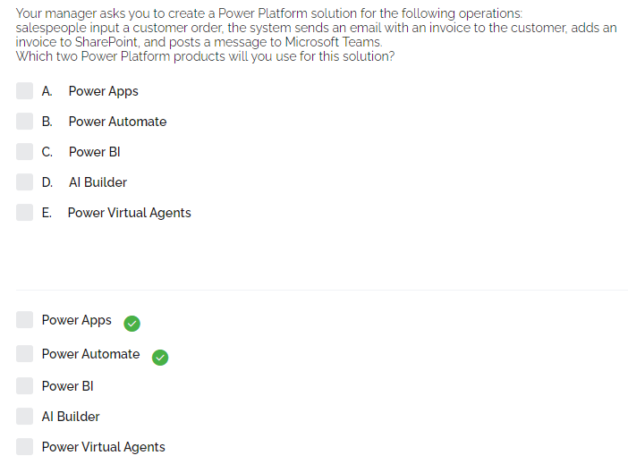
Practice Question

Slide 101

Practice Question

Slide 102

Practice Question

Slide 103

Practice Question

Slide 104

Practice Question

Slide 105

Practice Question

Slide 106

Practice Question

Slide 107

Practice Question

Slide 108

Practice Question

Slide 109

Practice Question

Slide 110

Practice Question

Slide 111

Practice Question

Slide 112

Practice Question

Slide 113

Practice Question

Slide 114

Practice Question

Slide 115

Practice Question

Slide 116

Practice Question

Slide 117

Practice Question

Slide 118

Practice Question

Slide 119

Practice Question

Slide 120

Practice Question

Slide 121

Practice Question

Slide 122

Practice Question

Slide 123

Practice Question

Slide 124

Practice Question

Slide 125

Practice Question

Slide 126

Practice Question

